Slide 1



Matrix Theory: Rank of Matrix -
FY BTECH SEM-I
MODULE-2
Sub Module 2.2

Slide 2
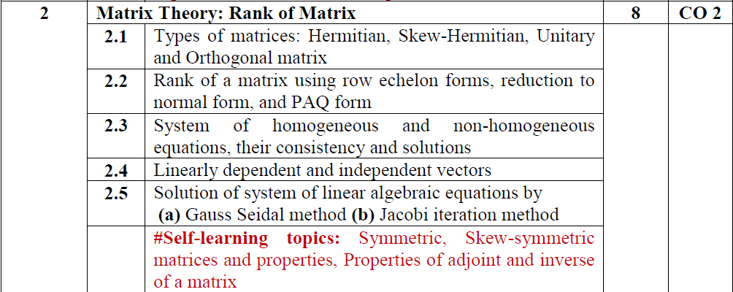

Slide 3
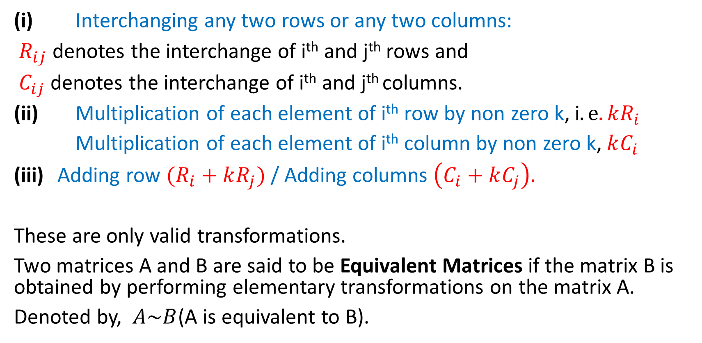
ELEMENTARY TRANFORMATIONS
(i) Interchanging any two rows or any two columns:
$R_{ij}$ denotes the interchange of i^{th} and j^{th} rows and
$C_{ij}$ denotes the interchange of i^{th} and j^{th} columns.
(ii) Multiplication of each element of i^{th} row by non zero k, i$.e. kR_{i}$
Multiplication of each element of i^{th} column by non zero k, $kC_{i}$
Adding row $(R_{i}+kR_{j})$ / Adding columns $\left(C_{i}+kC_{j}\right).$
These are only valid transformations.
Two matrices A and B are said to be Equivalent Matrices if the matrix B is obtained by performing elementary transformations on the matrix A.
Denoted by, $A\sim B$(A is equivalent to B).

Slide 4
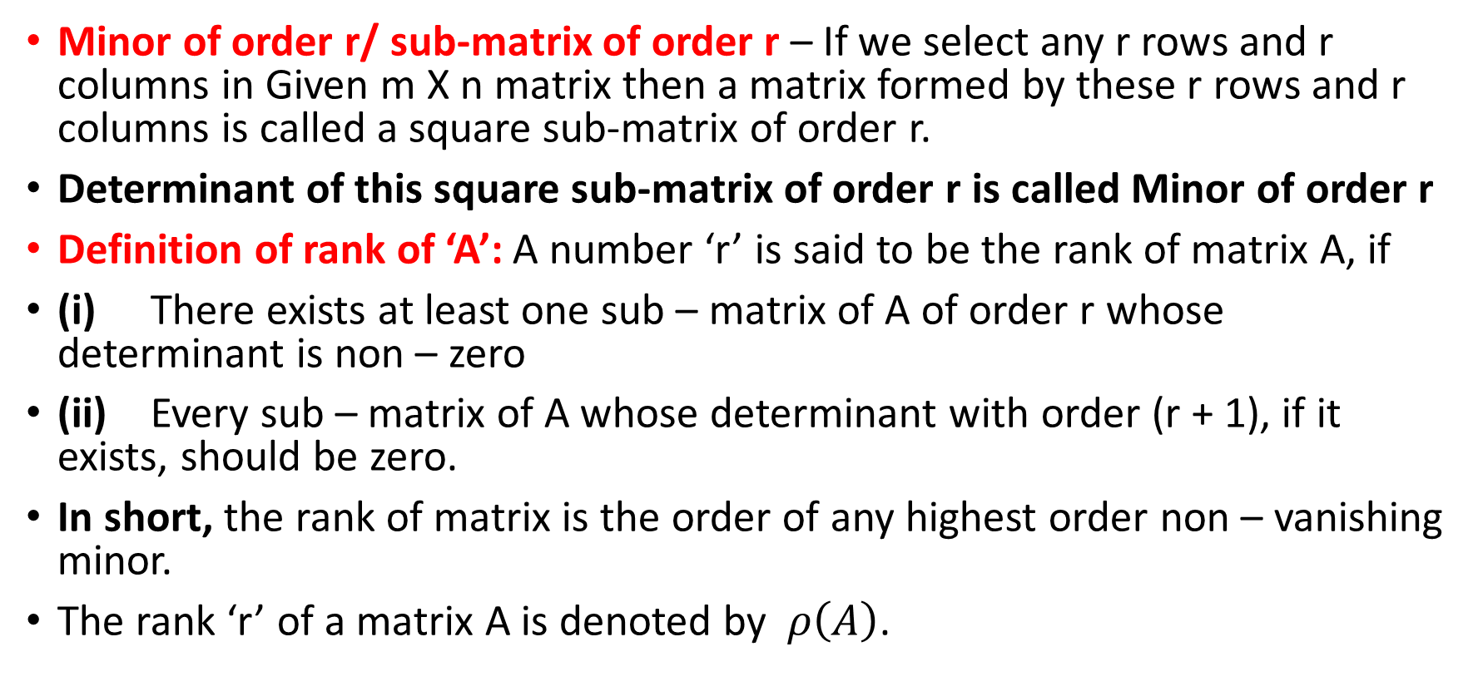
RANK OF A MATRIX
Minor of order r/ sub-matrix of order r – If we select any r rows and r columns in Given m X n matrix then a matrix formed by these r rows and r columns is called a square sub-matrix of order r.
Determinant of this square sub-matrix of order r is called Minor of order r
Definition of rank of ‘A’: A number ‘r’ is said to be the rank of matrix A, if
(i) There exists at least one sub – matrix of A of order r whose determinant is non – zero
(ii) Every sub – matrix of A whose determinant with order (r + 1), if it exists, should be zero.
In short, the rank of matrix is the order of any highest order non – vanishing minor.
The rank ‘r’ of a matrix A is denoted by $ρ\left(A\right)$.

Slide 5
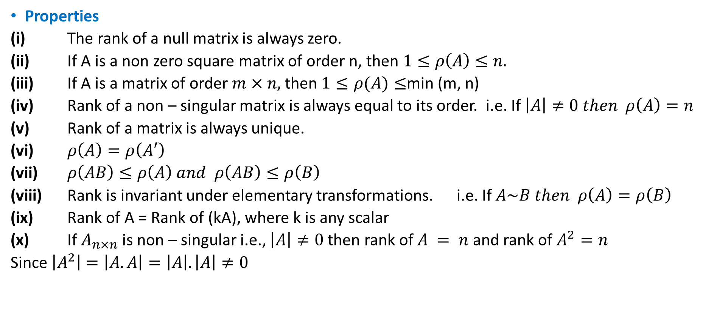
RANK OF A MATRIX
Properties
(i) The rank of a null matrix is always zero.
(ii) If A is a non zero square matrix of order n, then $1≤ρ\left(A\right)≤n.$
(iii) If A is a matrix of order $m×n,$ then $1≤ρ(A)≤$min (m, n)
(iv) Rank of a non – singular matrix is always equal to its order. i.e. If $\left|A\right|≠0 then ρ\left(A\right)=n$
(v) Rank of a matrix is always unique.
(vi) $ρ\left(A\right)=ρ\left(A′\right)$
(vii) $ρ\left(AB\right)≤ρ\left(A\right) and ρ\left(AB\right)≤ρ\left(B\right)$
(viii) Rank is invariant under elementary transformations. i.e. If $A\sim B then ρ\left(A\right)=ρ\left(B\right)$
(ix) Rank of A = Rank of (kA), where k is any scalar
(x) If $A_{n×n}$ is non – singular i.e., $\left|A\right|≠0$ then rank of $A = n$ and rank of $A^{2}=n$
Since $\left|A^{2}\right|=\left|A.A\right|=\left|A\right|.\left|A\right|≠0$

Slide 6
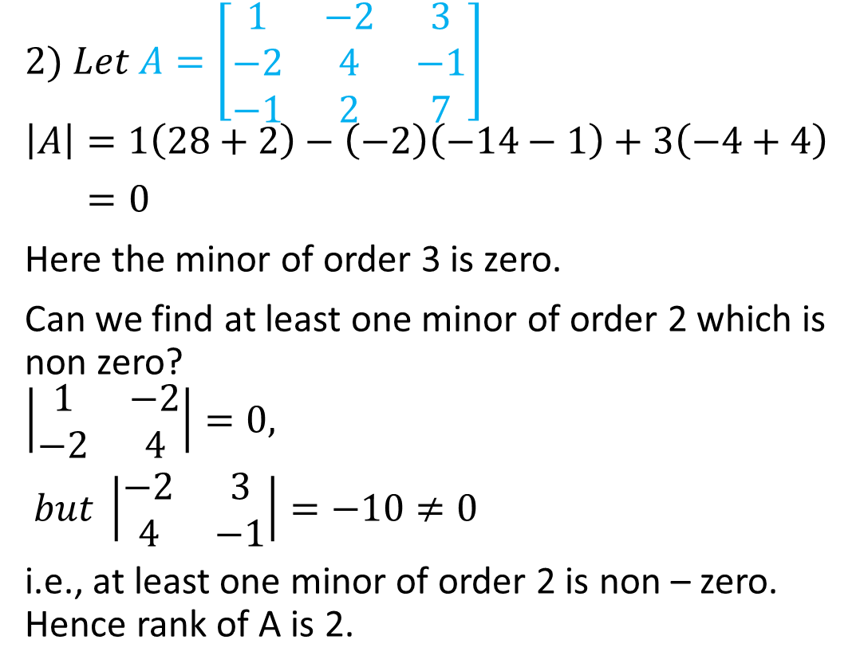
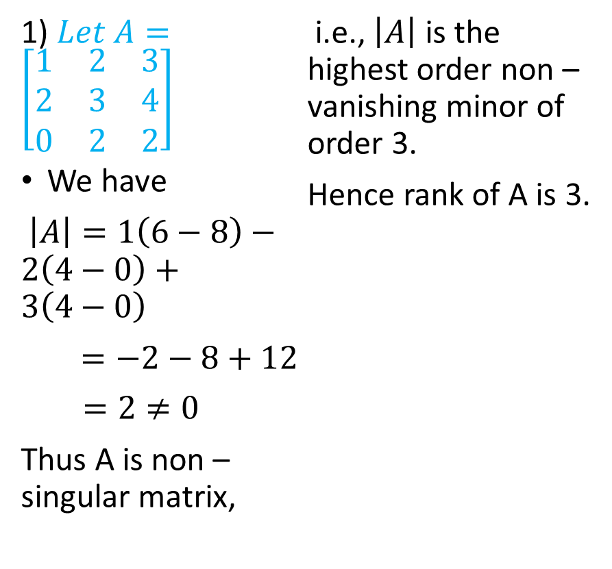
Examples Determine the ranks of the following matrices
1) $Let A=\left[\begin{matrix}1 & 2 & 3 \\ 2 & 3 & 4 \\ 0 & 2 & 2\end{matrix}\right]$
We have
$\left|A\right|=1\left(6−8\right)−2\left(4−0\right)+3\left(4−0\right)$
$=−2−8+12$
$=2≠0$
Thus A is non – singular matrix,
i.e., $\left|A\right|$ is the highest order non – vanishing minor of order 3.
Hence rank of A is 3.
$$2) Let A=\left[\begin{matrix}1 & −2 & 3 \\ −2 & 4 & −1 \\ −1 & 2 & 7\end{matrix}\right]$$
$$\left|A\right|=1\left(28+2\right)−\left(−2\right)\left(−14−1\right)+3\left(−4+4\right)$$
$=0$
Here the minor of order 3 is zero.
Can we find at least one minor of order 2 which is non zero?
$$\left|\begin{matrix}1 & −2 \\ −2 & 4\end{matrix}\right|=0,$$
$but \left|\begin{matrix}−2 & 3 \\ 4 & −1\end{matrix}\right|=−10≠0$
i.e., at least one minor of order 2 is non – zero. Hence rank of A is 2.

Slide 7
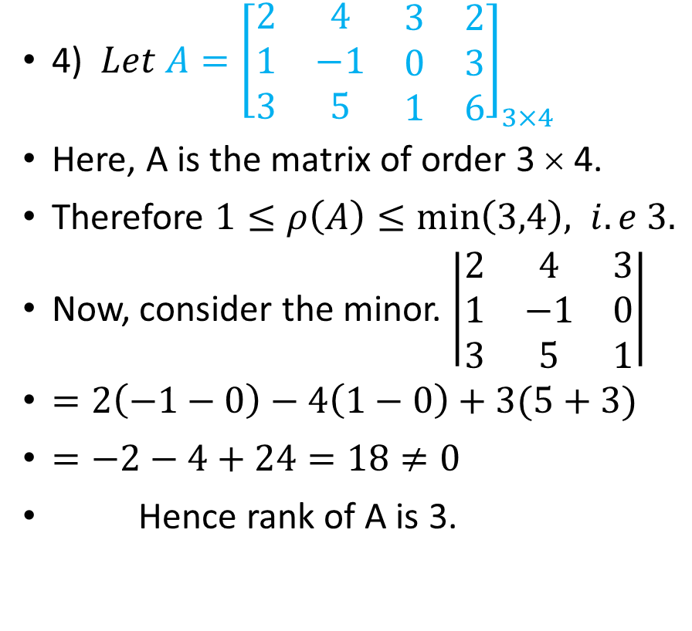
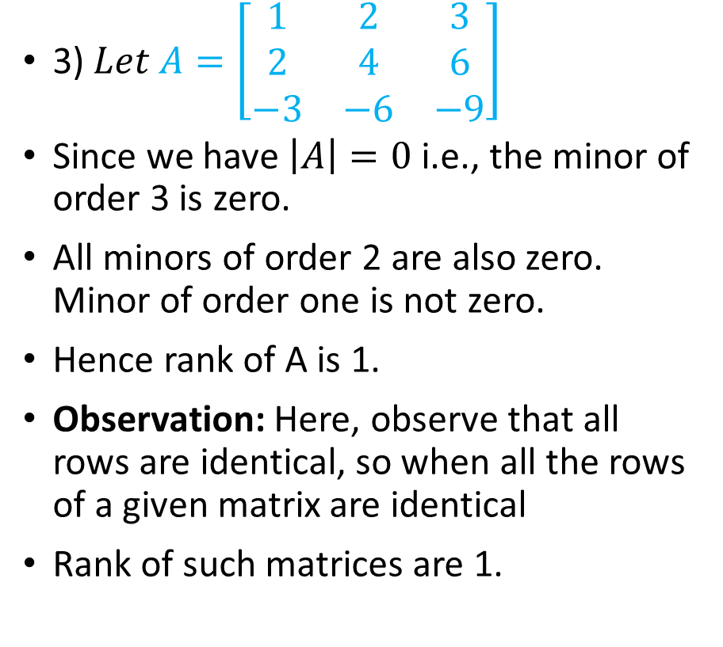
Examples Determine the ranks of the following matrices
3)$Let A=\left[\begin{matrix}1 & 2 & 3 \\ 2 & 4 & 6 \\ −3 & −6 & −9\end{matrix}\right]$
Since we have $\left|A\right|=0$ i.e., the minor of order 3 is zero.
All minors of order 2 are also zero. Minor of order one is not zero.
Hence rank of A is 1.
Observation: Here, observe that all rows are identical, so when all the rows of a given matrix are identical
Rank of such matrices are 1.
4) $Let A={\left[\begin{matrix}2 & 4 & \begin{matrix}3 & 2\end{matrix} \\ 1 & −1 & \begin{matrix}0 & 3\end{matrix} \\ 3 & 5 & \begin{matrix}1 & 6\end{matrix}\end{matrix}\right]}_{3×4}$
Here, A is the matrix of order 3 × 4.
Therefore $1≤ρ\left(A\right)≤\min\left(3,4\right), i.e 3.$
Now, consider the minor. $\left|\begin{matrix}2 & 4 & 3 \\ 1 & −1 & 0 \\ 3 & 5 & 1\end{matrix}\right|$
$=2\left(−1−0\right)−4\left(1−0\right)+3(5+3)$
$=−2−4+24=18≠0$
Hence rank of A is 3.

Slide 8
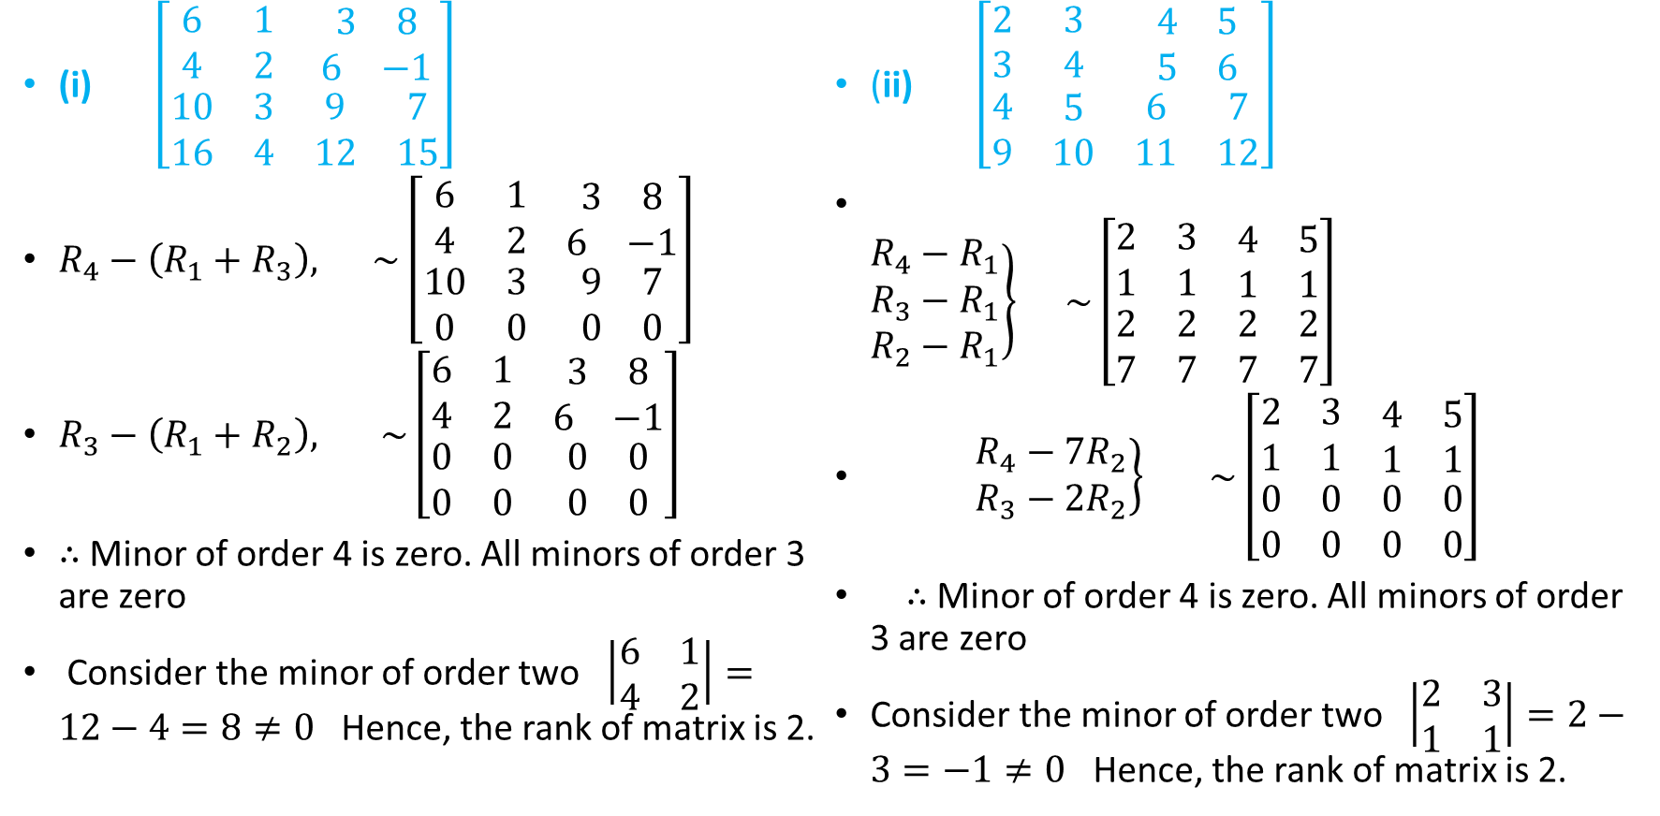
EXAMPLES Find the ranks of the following matrices
(i) $\left[\begin{matrix}6 & 1 & \begin{matrix}3 & 8\end{matrix} \\ 4 & 2 & \begin{matrix}6 & −1\end{matrix} \\ \begin{matrix}10 \\ 16\end{matrix} & \begin{matrix}3 \\ 4\end{matrix} & \begin{matrix}\begin{matrix}9 \\ 12\end{matrix} & \begin{matrix}7 \\ 15\end{matrix}\end{matrix}\end{matrix}\right]$
$R_{4}−\left(R_{1}+R_{3}\right),$ $\sim \left[\begin{matrix}6 & 1 & \begin{matrix}3 & 8\end{matrix} \\ 4 & 2 & \begin{matrix}6 & −1\end{matrix} \\ \begin{matrix}10 \\ 0\end{matrix} & \begin{matrix}3 \\ 0\end{matrix} & \begin{matrix}\begin{matrix}9 \\ 0\end{matrix} & \begin{matrix}7 \\ 0\end{matrix}\end{matrix}\end{matrix}\right]$
$R_{3}−\left(R_{1}+R_{2}\right),$ $\sim \left[\begin{matrix}6 & 1 & \begin{matrix}3 & 8\end{matrix} \\ 4 & 2 & \begin{matrix}6 & −1\end{matrix} \\ \begin{matrix}0 \\ 0\end{matrix} & \begin{matrix}0 \\ 0\end{matrix} & \begin{matrix}\begin{matrix}0 \\ 0\end{matrix} & \begin{matrix}0 \\ 0\end{matrix}\end{matrix}\end{matrix}\right]$
$∴$ Minor of order 4 is zero. All minors of order 3 are zero
Consider the minor of order two $\left|\begin{matrix}6 & 1 \\ 4 & 2\end{matrix}\right|=12−4=8≠0$ Hence, the rank of matrix is 2.
(ii) $\left[\begin{matrix}2 & 3 & \begin{matrix}4 & 5\end{matrix} \\ 3 & 4 & \begin{matrix}5 & 6\end{matrix} \\ \begin{matrix}4 \\ 9\end{matrix} & \begin{matrix}5 \\ 10\end{matrix} & \begin{matrix}\begin{matrix}6 \\ 11\end{matrix} & \begin{matrix}7 \\ 12\end{matrix}\end{matrix}\end{matrix}\right]$
$\left.\begin{matrix}R_{4}−R_{1} \\ R_{3}−R_{1} \\ R_{2}−R_{1}\end{matrix}\right\} \sim \left[\begin{matrix}2 & 3 & \begin{matrix}4 & 5\end{matrix} \\ 1 & 1 & \begin{matrix}1 & 1\end{matrix} \\ \begin{matrix}2 \\ 7\end{matrix} & \begin{matrix}2 \\ 7\end{matrix} & \begin{matrix}\begin{matrix}2 \\ 7\end{matrix} & \begin{matrix}2 \\ 7\end{matrix}\end{matrix}\end{matrix}\right]$
$\left.\begin{matrix}R_{4}−7R_{2} \\ R_{3}−{2R}_{2}\end{matrix}\right\} \sim \left[\begin{matrix}2 & 3 & \begin{matrix}4 & 5\end{matrix} \\ 1 & 1 & \begin{matrix}1 & 1\end{matrix} \\ \begin{matrix}0 \\ 0\end{matrix} & \begin{matrix}0 \\ 0\end{matrix} & \begin{matrix}\begin{matrix}0 \\ 0\end{matrix} & \begin{matrix}0 \\ 0\end{matrix}\end{matrix}\end{matrix}\right]$
$∴$ Minor of order 4 is zero. All minors of order 3 are zero
Consider the minor of order two $\left|\begin{matrix}2 & 3 \\ 1 & 1\end{matrix}\right|=2−3=−1≠0$ Hence, the rank of matrix is 2.

Slide 9
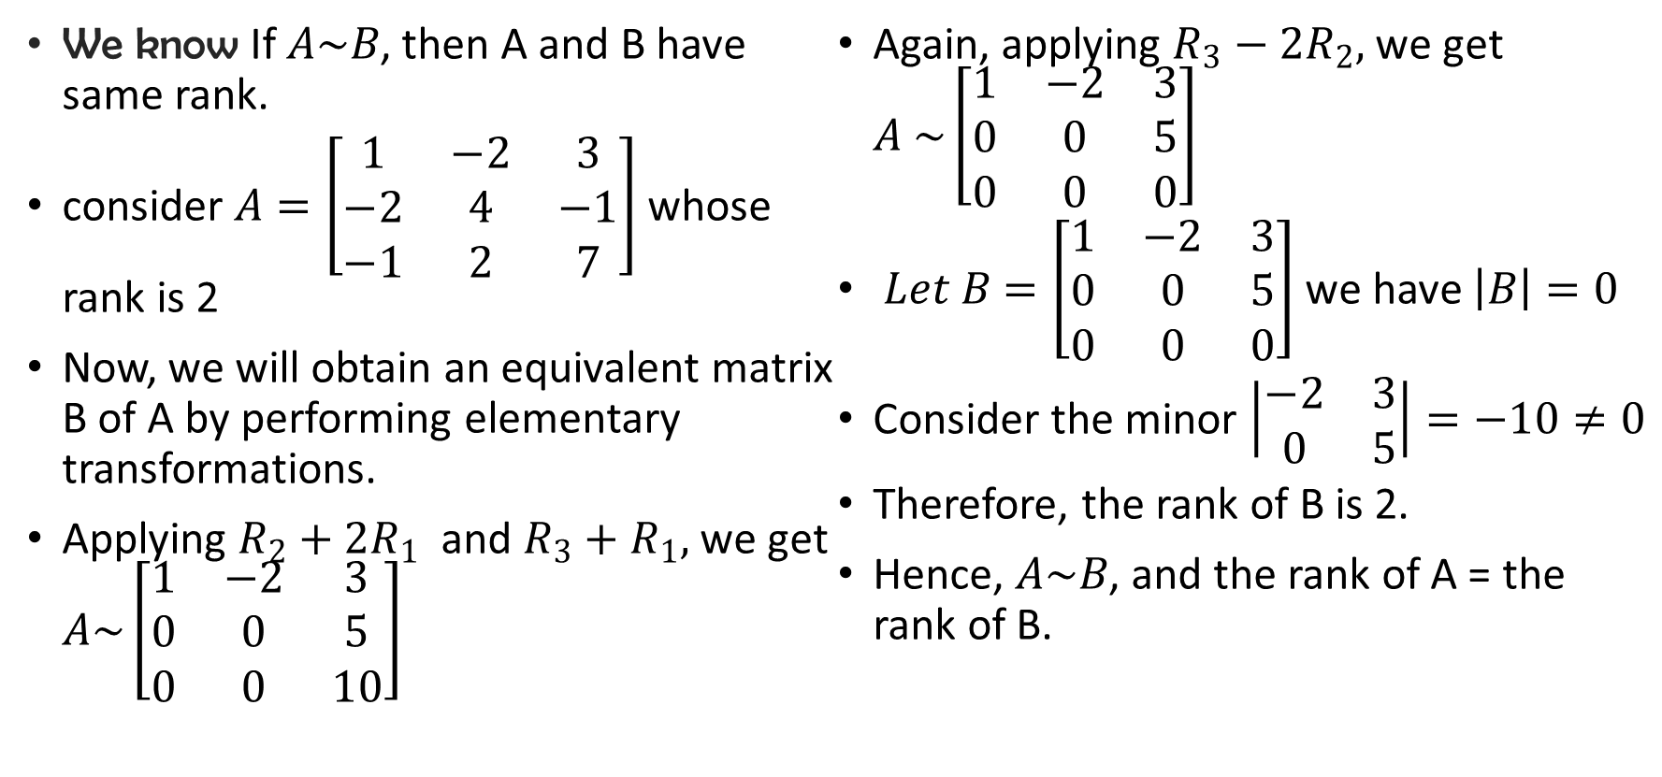
Finding rank by row echelon method
We know If $A\sim B$, then A and B have same rank.
consider $A=\left[\begin{matrix}1 & −2 & 3 \\ −2 & 4 & −1 \\ −1 & 2 & 7\end{matrix}\right]$ whose rank is 2
Now, we will obtain an equivalent matrix B of A by performing elementary transformations.
Applying $R_{2}+2R_{1}$ and $R_{3}+R_{1},$ we get $A\sim \left[\begin{matrix}1 & −2 & 3 \\ 0 & 0 & 5 \\ 0 & 0 & 10\end{matrix}\right]$
Again, applying $R_{3}−{2R}_{2},$ we get $A \sim \left[\begin{matrix}1 & −2 & 3 \\ 0 & 0 & 5 \\ 0 & 0 & 0\end{matrix}\right]$
$Let B=\left[\begin{matrix}1 & −2 & 3 \\ 0 & 0 & 5 \\ 0 & 0 & 0\end{matrix}\right]$we have $\left|B\right|=0$
Consider the minor $\left|\begin{matrix}−2 & 3 \\ 0 & 5\end{matrix}\right|=−10≠0$
Therefore, the rank of B is 2.
Hence, $A\sim B$, and the rank of A = the rank of B.

Slide 10
ECHELON FORM OF A MATRIX
Definition: If a matrix A is reduced to a matrix B by using elementary row transformations alone, then B is said to be row equivalent to A.
Defn: The Echelon form or Canonical form of a matrix A is a row equivalent matrix of rank ’r’ in which
(a) One or more elements of each of the first r rows are non – zero while all other rows have only zero elements, (i.e all zero rows, if any, are placed at the bottom of the matrix so that the first r rows form an upper triangular matrix).
(b) The number of zero before the first non – zero element in a row is less than the number of such zeros in the next row.
In short, by performing only row transformations, a given matrix that is reduced to an upper triangular form is called its Echelon form.
Note: Rank of a given matrix is equal to the number of non – zero rows in the Echelon form.

Slide 11
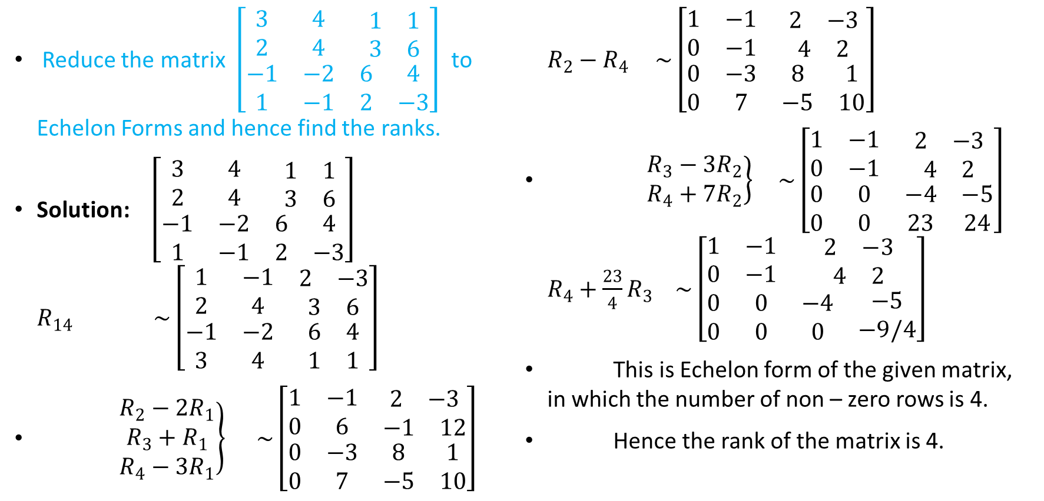
EXAMPLES
Reduce the matrix $\left[\begin{matrix}3 & 4 & \begin{matrix}1 & 1\end{matrix} \\ 2 & 4 & \begin{matrix}3 & 6\end{matrix} \\ \begin{matrix}−1 \\ 1\end{matrix} & \begin{matrix}−2 \\ −1\end{matrix} & \begin{matrix}\begin{matrix}6 \\ 2\end{matrix} & \begin{matrix}4 \\ −3\end{matrix}\end{matrix}\end{matrix}\right]$ to Echelon Forms and hence find the ranks.
Solution: $\left[\begin{matrix}3 & 4 & \begin{matrix}1 & 1\end{matrix} \\ 2 & 4 & \begin{matrix}3 & 6\end{matrix} \\ \begin{matrix}−1 \\ 1\end{matrix} & \begin{matrix}−2 \\ −1\end{matrix} & \begin{matrix}\begin{matrix}6 \\ 2\end{matrix} & \begin{matrix}4 \\ −3\end{matrix}\end{matrix}\end{matrix}\right]$ $R_{14} \sim \left[\begin{matrix}1 & −1 & \begin{matrix}2 & −3\end{matrix} \\ 2 & 4 & \begin{matrix}3 & 6\end{matrix} \\ \begin{matrix}−1 \\ 3\end{matrix} & \begin{matrix}−2 \\ 4\end{matrix} & \begin{matrix}\begin{matrix}6 \\ 1\end{matrix} & \begin{matrix}4 \\ 1\end{matrix}\end{matrix}\end{matrix}\right]$
$\left.\begin{matrix}R_{2}−2R_{1} \\ R_{3}+R_{1} \\ R_{4}−3R_{1}\end{matrix}\right\} \sim \left[\begin{matrix}1 & −1 & \begin{matrix}2 & −3\end{matrix} \\ 0 & 6 & \begin{matrix}−1 & 12\end{matrix} \\ \begin{matrix}0 \\ 0\end{matrix} & \begin{matrix}−3 \\ 7\end{matrix} & \begin{matrix}\begin{matrix}8 \\ −5\end{matrix} & \begin{matrix}1 \\ 10\end{matrix}\end{matrix}\end{matrix}\right]$ $R_{2}−R_{4 } \sim \left[\begin{matrix}1 & −1 & \begin{matrix}2 & −3\end{matrix} \\ 0 & −1 & \begin{matrix}4 & 2\end{matrix} \\ \begin{matrix}0 \\ 0\end{matrix} & \begin{matrix}−3 \\ 7\end{matrix} & \begin{matrix}\begin{matrix}8 \\ −5\end{matrix} & \begin{matrix}1 \\ 10\end{matrix}\end{matrix}\end{matrix}\right]$
$\left.\begin{matrix}R_{3}−3R_{2} \\ R_{4}+7R_{2}\end{matrix}\right\} \sim \left[\begin{matrix}1 & −1 & \begin{matrix}2 & −3\end{matrix} \\ 0 & −1 & \begin{matrix}4 & 2\end{matrix} \\ \begin{matrix}0 \\ 0\end{matrix} & \begin{matrix}0 \\ 0\end{matrix} & \begin{matrix}\begin{matrix}−4 \\ 23\end{matrix} & \begin{matrix}−5 \\ 24\end{matrix}\end{matrix}\end{matrix}\right]$ $R_{4}+\frac{23}{4}R_{3} \sim \left[\begin{matrix}1 & −1 & \begin{matrix}2 & −3\end{matrix} \\ 0 & −1 & \begin{matrix}4 & 2\end{matrix} \\ \begin{matrix}0 \\ 0\end{matrix} & \begin{matrix}0 \\ 0\end{matrix} & \begin{matrix}\begin{matrix}−4 \\ 0\end{matrix} & \begin{matrix}−5 \\ −9/4\end{matrix}\end{matrix}\end{matrix}\right]$
This is Echelon form of the given matrix, in which the number of non – zero rows is 4.
Hence the rank of the matrix is 4.

Slide 12
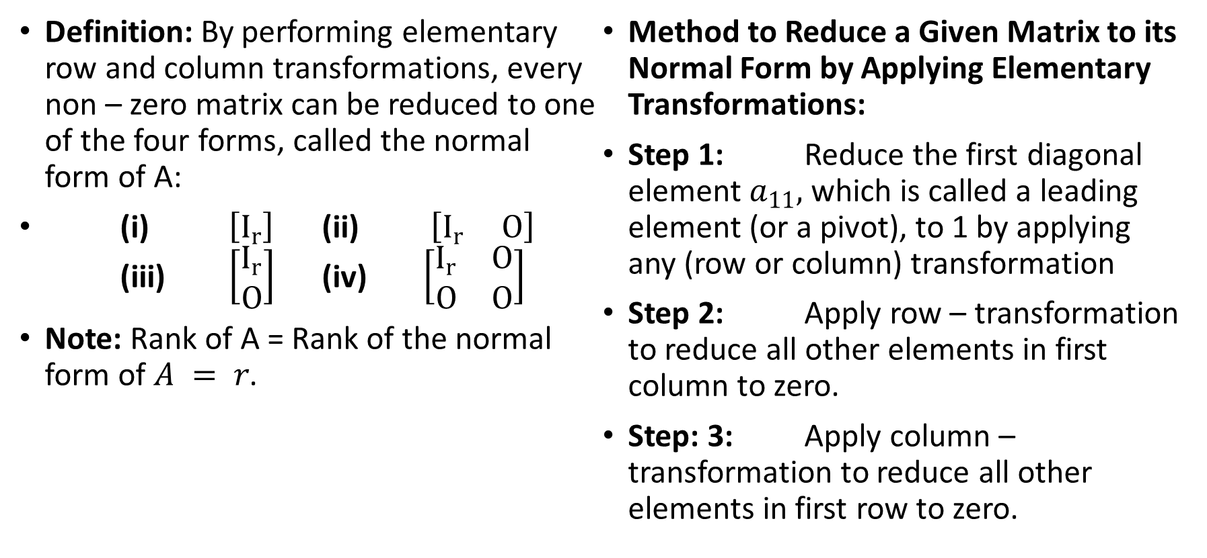
NORMAL FORM OF A MATRIX
Definition: By performing elementary row and column transformations, every non – zero matrix can be reduced to one of the four forms, called the normal form of A:
(i) $\left[I_{r}\right]$ (ii) $\left[I_{r} O\right]$ (iii) $\left[\begin{matrix}I_{r} \\ O\end{matrix}\right]$ (iv) $\left[\begin{matrix}I_{r} & O \\ O & O\end{matrix}\right]$
Note: Rank of A = Rank of the normal form of $A = r$.
Method to Reduce a Given Matrix to its Normal Form by Applying Elementary Transformations:
Step 1: Reduce the first diagonal element $a_{11},$ which is called a leading element (or a pivot), to 1 by applying any (row or column) transformation
Step 2: Apply row – transformation to reduce all other elements in first column to zero.
Step: 3: Apply column – transformation to reduce all other elements in first row to zero.

Slide 13
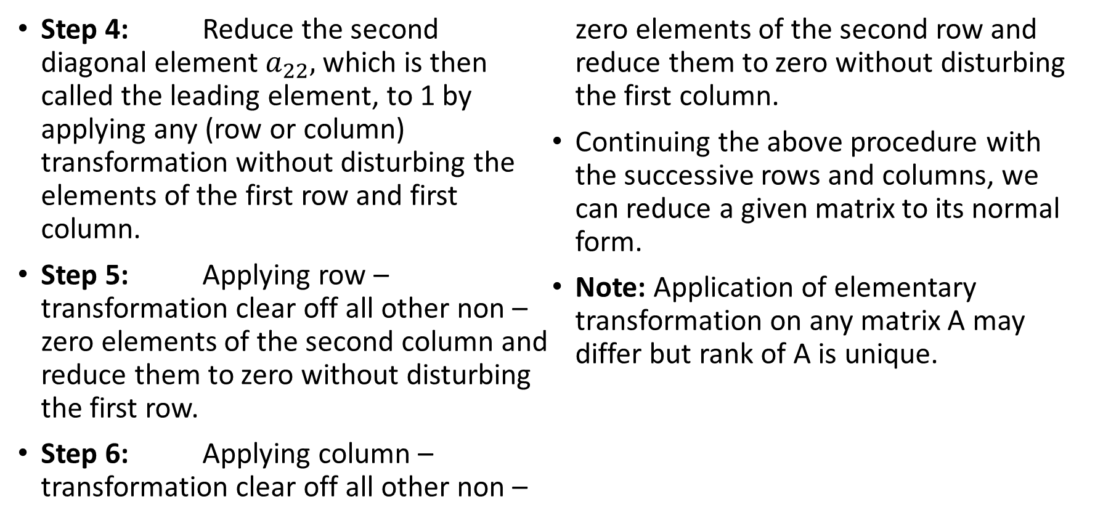
NORMAL FORM OF A MATRIX
Step 4: Reduce the second diagonal element $a_{22},$ which is then called the leading element, to 1 by applying any (row or column) transformation without disturbing the elements of the first row and first column.
Step 5: Applying row – transformation clear off all other non – zero elements of the second column and reduce them to zero without disturbing the first row.
Step 6: Applying column – transformation clear off all other non – zero elements of the second row and reduce them to zero without disturbing the first column.
Continuing the above procedure with the successive rows and columns, we can reduce a given matrix to its normal form.
Note: Application of elementary transformation on any matrix A may differ but rank of A is unique.

Slide 14
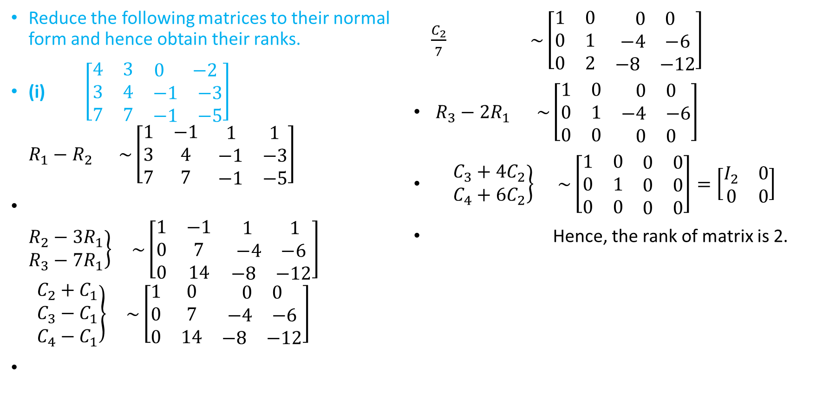
EXAMPLES
Reduce the following matrices to their normal form and hence obtain their ranks.
(i) $\left[\begin{matrix}4 & 3 & \begin{matrix}0 & −2\end{matrix} \\ 3 & 4 & \begin{matrix}−1 & −3\end{matrix} \\ 7 & 7 & \begin{matrix}−1 & −5\end{matrix}\end{matrix}\right]$ $R_{1}−R_{2} \sim \left[\begin{matrix}1 & −1 & \begin{matrix}1 & 1\end{matrix} \\ 3 & 4 & \begin{matrix}−1 & −3\end{matrix} \\ 7 & 7 & \begin{matrix}−1 & −5\end{matrix}\end{matrix}\right]$
$\left.\begin{matrix}R_{2}−{3R}_{1} \\ R_{3}−7R_{1}\end{matrix}\right\} \sim \left[\begin{matrix}1 & −1 & \begin{matrix}1 & 1\end{matrix} \\ 0 & 7 & \begin{matrix}−4 & −6\end{matrix} \\ 0 & 14 & \begin{matrix}−8 & −12\end{matrix}\end{matrix}\right]$ $\left.\begin{matrix}C_{2}+C_{1} \\ C_{3}−C_{1} \\ C_{4}−C_{1}\end{matrix}\right\} \sim \left[\begin{matrix}1 & 0 & \begin{matrix}0 & 0\end{matrix} \\ 0 & 7 & \begin{matrix}−4 & −6\end{matrix} \\ 0 & 14 & \begin{matrix}−8 & −12\end{matrix}\end{matrix}\right]$
$\frac{C_{2}}{7} \sim \left[\begin{matrix}1 & 0 & \begin{matrix}0 & 0\end{matrix} \\ 0 & 1 & \begin{matrix}−4 & −6\end{matrix} \\ 0 & 2 & \begin{matrix}−8 & −12\end{matrix}\end{matrix}\right]$
$R_{3}−2R_{1 }\sim \left[\begin{matrix}1 & 0 & \begin{matrix}0 & 0\end{matrix} \\ 0 & 1 & \begin{matrix}−4 & −6\end{matrix} \\ 0 & 0 & \begin{matrix}0 & 0\end{matrix}\end{matrix}\right]$
$\left.\begin{matrix}C_{3}+4C_{2} \\ C_{4}+6C_{2}\end{matrix}\right\} \sim \left[\begin{matrix}1 & 0 & \begin{matrix}0 & 0\end{matrix} \\ 0 & 1 & \begin{matrix}0 & 0\end{matrix} \\ 0 & 0 & \begin{matrix}0 & 0\end{matrix}\end{matrix}\right]=\left[\begin{matrix}I_{2} & 0 \\ 0 & 0\end{matrix}\right]$
Hence, the rank of matrix is 2.

Slide 15


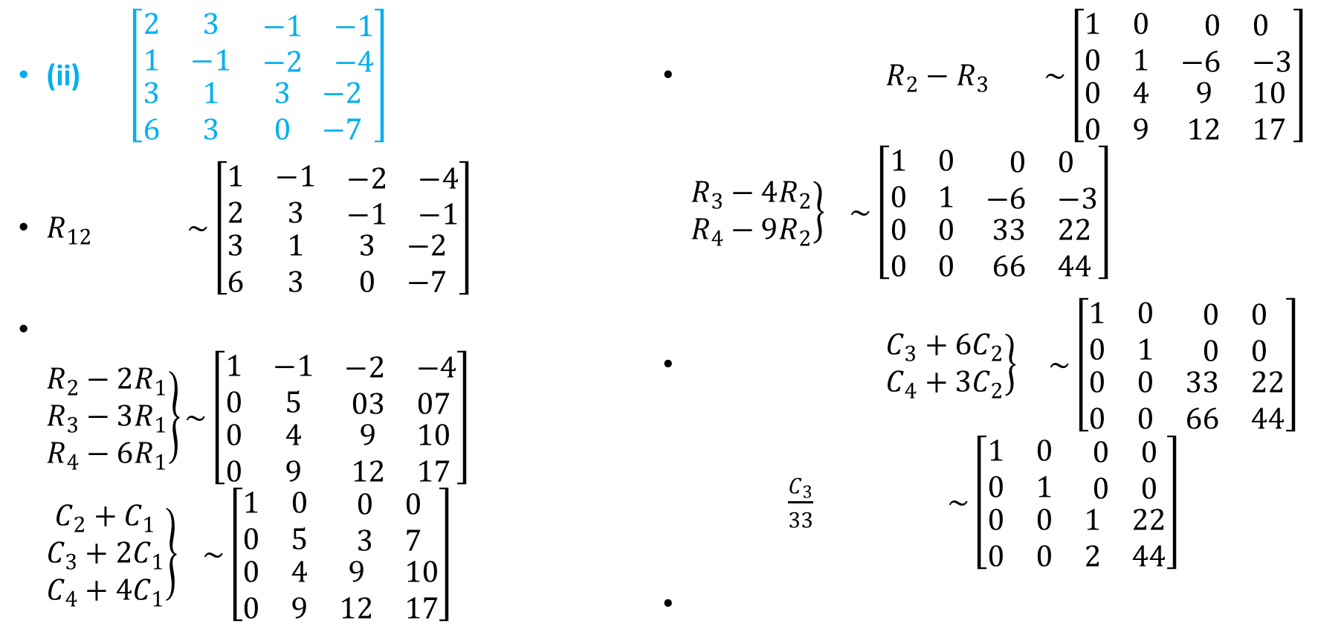
EXAMPLES
(ii) $\left[\begin{matrix}2 & 3 & \begin{matrix}−1 & −1\end{matrix} \\ 1 & −1 & \begin{matrix}−2 & −4\end{matrix} \\ \begin{matrix}3 \\ 6\end{matrix} & \begin{matrix}1 \\ 3\end{matrix} & \begin{matrix}\begin{matrix}3 \\ 0\end{matrix} & \begin{matrix}−2 \\ −7\end{matrix}\end{matrix}\end{matrix}\right]$
$R_{12} \sim \left[\begin{matrix}1 & −1 & \begin{matrix}−2 & −4\end{matrix} \\ 2 & 3 & \begin{matrix}−1 & −1\end{matrix} \\ \begin{matrix}3 \\ 6\end{matrix} & \begin{matrix}1 \\ 3\end{matrix} & \begin{matrix}\begin{matrix}3 \\ 0\end{matrix} & \begin{matrix}−2 \\ −7\end{matrix}\end{matrix}\end{matrix}\right]$
$\left.\begin{matrix}R_{2}−2R_{1} \\ R_{3}−3R_{1} \\ R_{4}−6R_{1}\end{matrix}\right\}\sim \left[\begin{matrix}1 & −1 & \begin{matrix}−2 & −4\end{matrix} \\ 0 & 5 & \begin{matrix}03 & 07\end{matrix} \\ \begin{matrix}0 \\ 0\end{matrix} & \begin{matrix}4 \\ 9\end{matrix} & \begin{matrix}\begin{matrix}9 \\ 12\end{matrix} & \begin{matrix}10 \\ 17\end{matrix}\end{matrix}\end{matrix}\right]$ $\left.\begin{matrix}C_{2}+C_{1} \\ C_{3}+2C_{1} \\ C_{4}+4C_{1}\end{matrix}\right\} \sim \left[\begin{matrix}1 & 0 & \begin{matrix}0 & 0\end{matrix} \\ 0 & 5 & \begin{matrix}3 & 7\end{matrix} \\ \begin{matrix}0 \\ 0\end{matrix} & \begin{matrix}4 \\ 9\end{matrix} & \begin{matrix}\begin{matrix}9 \\ 12\end{matrix} & \begin{matrix}10 \\ 17\end{matrix}\end{matrix}\end{matrix}\right]$
$R_{2}−R_{3} \sim \left[\begin{matrix}1 & 0 & \begin{matrix}0 & 0\end{matrix} \\ 0 & 1 & \begin{matrix}−6 & −3\end{matrix} \\ \begin{matrix}0 \\ 0\end{matrix} & \begin{matrix}4 \\ 9\end{matrix} & \begin{matrix}\begin{matrix}9 \\ 12\end{matrix} & \begin{matrix}10 \\ 17\end{matrix}\end{matrix}\end{matrix}\right]$ $\left.\begin{matrix}R_{3}−4R_{2} \\ R_{4}−9R_{2}\end{matrix}\right\} \sim \left[\begin{matrix}1 & 0 & \begin{matrix}0 & 0\end{matrix} \\ 0 & 1 & \begin{matrix}−6 & −3\end{matrix} \\ \begin{matrix}0 \\ 0\end{matrix} & \begin{matrix}0 \\ 0\end{matrix} & \begin{matrix}\begin{matrix}33 \\ 66\end{matrix} & \begin{matrix}22 \\ 44\end{matrix}\end{matrix}\end{matrix}\right]$
$\left.\begin{matrix}C_{3}+6C_{2} \\ C_{4}+3C_{2}\end{matrix}\right\} \sim \left[\begin{matrix}1 & 0 & \begin{matrix}0 & 0\end{matrix} \\ 0 & 1 & \begin{matrix}0 & 0\end{matrix} \\ \begin{matrix}0 \\ 0\end{matrix} & \begin{matrix}0 \\ 0\end{matrix} & \begin{matrix}\begin{matrix}33 \\ 66\end{matrix} & \begin{matrix}22 \\ 44\end{matrix}\end{matrix}\end{matrix}\right]$ $\frac{C_{3}}{33} \sim \left[\begin{matrix}1 & 0 & \begin{matrix}0 & 0\end{matrix} \\ 0 & 1 & \begin{matrix}0 & 0\end{matrix} \\ \begin{matrix}0 \\ 0\end{matrix} & \begin{matrix}0 \\ 0\end{matrix} & \begin{matrix}\begin{matrix}1 \\ 2\end{matrix} & \begin{matrix}22 \\ 44\end{matrix}\end{matrix}\end{matrix}\right]$

Slide 16

EXAMPLES
$R_{4}−{2R}_{3} \sim \left[\begin{matrix}1 & 0 & \begin{matrix}0 & 0\end{matrix} \\ 0 & 1 & \begin{matrix}0 & 0\end{matrix} \\ \begin{matrix}0 \\ 0\end{matrix} & \begin{matrix}0 \\ 0\end{matrix} & \begin{matrix}\begin{matrix}1 \\ 0\end{matrix} & \begin{matrix}22 \\ 0\end{matrix}\end{matrix}\end{matrix}\right]$
$C_{4}−22C_{3} \sim \left[\begin{matrix}1 & 0 & \begin{matrix}0 & 0\end{matrix} \\ 0 & 1 & \begin{matrix}0 & 0\end{matrix} \\ \begin{matrix}0 \\ 0\end{matrix} & \begin{matrix}0 \\ 0\end{matrix} & \begin{matrix}\begin{matrix}1 \\ 0\end{matrix} & \begin{matrix}0 \\ 0\end{matrix}\end{matrix}\end{matrix}\right]=\left[\begin{matrix}I_{3} & 0 \\ 0 & 0\end{matrix}\right]$
Hence, the rank of matrix is 3.

Slide 17
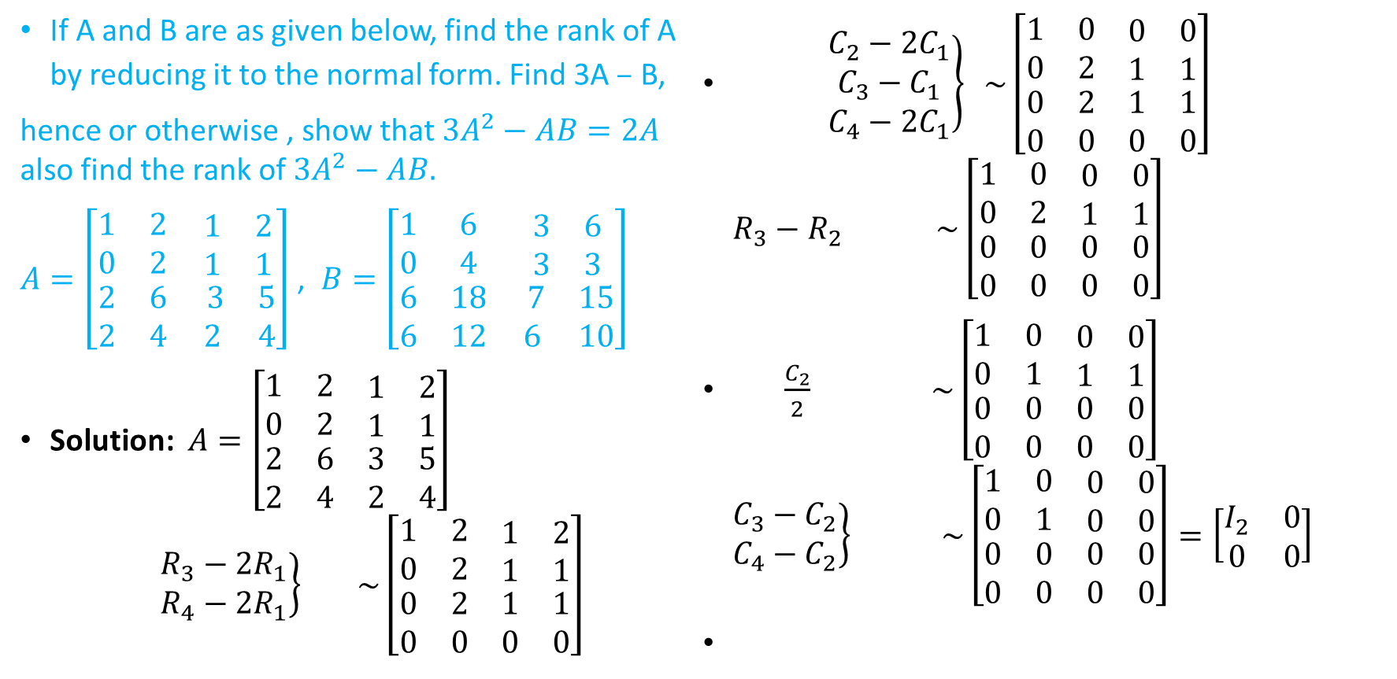
EXAMPLES
If A and B are as given below, find the rank of A by reducing it to the normal form. Find 3A$–$ B,
hence or otherwise , show that ${3A}^{2}−AB=2A$ also find the rank of ${3A}^{2}−AB.$
$A=\left[\begin{matrix}1 & 2 & \begin{matrix}1 & 2\end{matrix} \\ 0 & 2 & \begin{matrix}1 & 1\end{matrix} \\ \begin{matrix}2 \\ 2\end{matrix} & \begin{matrix}6 \\ 4\end{matrix} & \begin{matrix}\begin{matrix} 3 \\ 2\end{matrix} & \begin{matrix}5 \\ 4\end{matrix}\end{matrix}\end{matrix}\right]$ , $B=\left[\begin{matrix}1 & 6 & \begin{matrix}3 & 6\end{matrix} \\ 0 & 4 & \begin{matrix}3 & 3\end{matrix} \\ \begin{matrix}6 \\ 6\end{matrix} & \begin{matrix}18 \\ 12\end{matrix} & \begin{matrix}\begin{matrix} 7 \\ 6\end{matrix} & \begin{matrix}15 \\ 10\end{matrix}\end{matrix}\end{matrix}\right]$
Solution: $A=\left[\begin{matrix}1 & 2 & \begin{matrix}1 & 2\end{matrix} \\ 0 & 2 & \begin{matrix}1 & 1\end{matrix} \\ \begin{matrix}2 \\ 2\end{matrix} & \begin{matrix}6 \\ 4\end{matrix} & \begin{matrix}\begin{matrix}3 \\ 2\end{matrix} & \begin{matrix}5 \\ 4\end{matrix}\end{matrix}\end{matrix}\right]$ $\left.\begin{matrix}R_{3}−2R_{1} \\ R_{4}−2R_{1}\end{matrix}\right\} \sim \left[\begin{matrix}1 & 2 & \begin{matrix}1 & 2\end{matrix} \\ 0 & 2 & \begin{matrix}1 & 1\end{matrix} \\ \begin{matrix}0 \\ 0\end{matrix} & \begin{matrix}2 \\ 0\end{matrix} & \begin{matrix}\begin{matrix}1 \\ 0\end{matrix} & \begin{matrix}1 \\ 0\end{matrix}\end{matrix}\end{matrix}\right]$
$\left.\begin{matrix}C_{2}−2C_{1} \\ C_{3}−C_{1} \\ C_{4}−2C_{1}\end{matrix}\right\} \sim \left[\begin{matrix}1 & 0 & \begin{matrix}0 & 0\end{matrix} \\ 0 & 2 & \begin{matrix}1 & 1\end{matrix} \\ \begin{matrix}0 \\ 0\end{matrix} & \begin{matrix}2 \\ 0\end{matrix} & \begin{matrix}\begin{matrix}1 \\ 0\end{matrix} & \begin{matrix}1 \\ 0\end{matrix}\end{matrix}\end{matrix}\right]$ $R_{3}−R_{2} \sim \left[\begin{matrix}1 & 0 & \begin{matrix}0 & 0\end{matrix} \\ 0 & 2 & \begin{matrix}1 & 1\end{matrix} \\ \begin{matrix}0 \\ 0\end{matrix} & \begin{matrix}0 \\ 0\end{matrix} & \begin{matrix}\begin{matrix}0 \\ 0\end{matrix} & \begin{matrix}0 \\ 0\end{matrix}\end{matrix}\end{matrix}\right]$
$\frac{C_{2}}{2} \sim \left[\begin{matrix}1 & 0 & \begin{matrix}0 & 0\end{matrix} \\ 0 & 1 & \begin{matrix}1 & 1\end{matrix} \\ \begin{matrix}0 \\ 0\end{matrix} & \begin{matrix}0 \\ 0\end{matrix} & \begin{matrix}\begin{matrix}0 \\ 0\end{matrix} & \begin{matrix}0 \\ 0\end{matrix}\end{matrix}\end{matrix}\right]$ $\left.\begin{matrix}C_{3}−C_{2} \\ C_{4}−C_{2}\end{matrix}\right\} \sim \left[\begin{matrix}1 & 0 & \begin{matrix}0 & 0\end{matrix} \\ 0 & 1 & \begin{matrix}0 & 0\end{matrix} \\ \begin{matrix}0 \\ 0\end{matrix} & \begin{matrix}0 \\ 0\end{matrix} & \begin{matrix}\begin{matrix}0 \\ 0\end{matrix} & \begin{matrix}0 \\ 0\end{matrix}\end{matrix}\end{matrix}\right]=\left[\begin{matrix}I_{2} & 0 \\ 0 & 0\end{matrix}\right]$

Slide 18
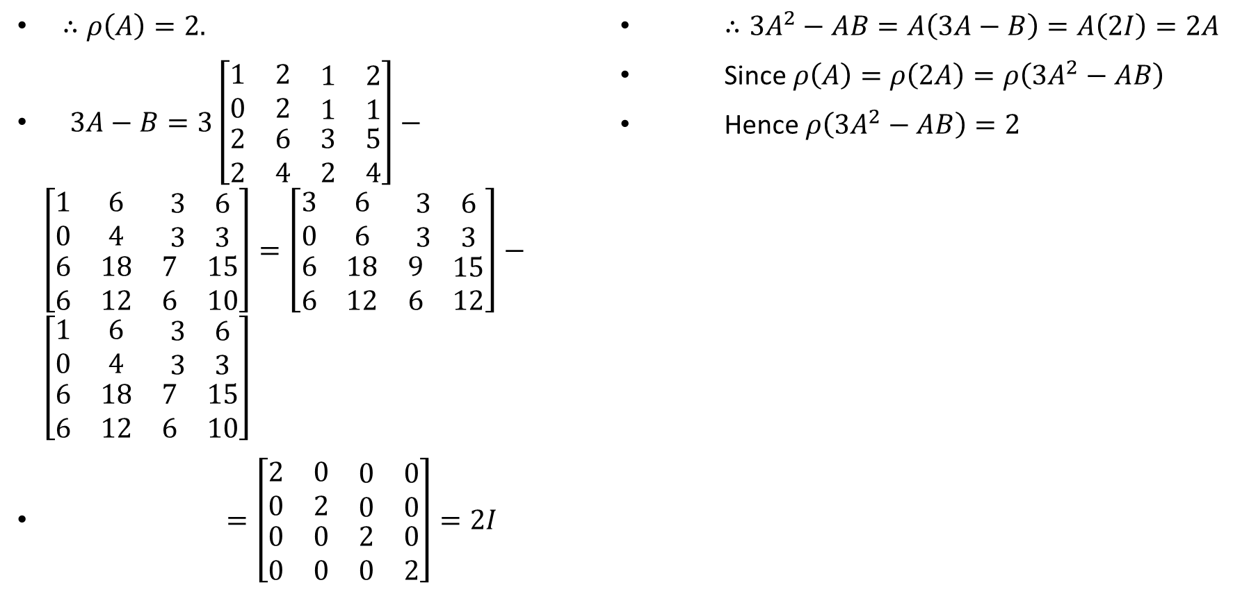
EXAMPLES
$∴ρ\left(A\right)=2.$
$3A−B=3\left[\begin{matrix}1 & 2 & \begin{matrix}1 & 2\end{matrix} \\ 0 & 2 & \begin{matrix}1 & 1\end{matrix} \\ \begin{matrix}2 \\ 2\end{matrix} & \begin{matrix}6 \\ 4\end{matrix} & \begin{matrix}\begin{matrix}3 \\ 2\end{matrix} & \begin{matrix}5 \\ 4\end{matrix}\end{matrix}\end{matrix}\right]−\left[\begin{matrix}1 & 6 & \begin{matrix}3 & 6\end{matrix} \\ 0 & 4 & \begin{matrix}3 & 3\end{matrix} \\ \begin{matrix}6 \\ 6\end{matrix} & \begin{matrix}18 \\ 12\end{matrix} & \begin{matrix}\begin{matrix}7 \\ 6\end{matrix} & \begin{matrix}15 \\ 10\end{matrix}\end{matrix}\end{matrix}\right]=\left[\begin{matrix}3 & 6 & \begin{matrix}3 & 6\end{matrix} \\ 0 & 6 & \begin{matrix}3 & 3\end{matrix} \\ \begin{matrix}6 \\ 6\end{matrix} & \begin{matrix}18 \\ 12\end{matrix} & \begin{matrix}\begin{matrix}9 \\ 6\end{matrix} & \begin{matrix}15 \\ 12\end{matrix}\end{matrix}\end{matrix}\right]−\left[\begin{matrix}1 & 6 & \begin{matrix}3 & 6\end{matrix} \\ 0 & 4 & \begin{matrix}3 & 3\end{matrix} \\ \begin{matrix}6 \\ 6\end{matrix} & \begin{matrix}18 \\ 12\end{matrix} & \begin{matrix}\begin{matrix}7 \\ 6\end{matrix} & \begin{matrix}15 \\ 10\end{matrix}\end{matrix}\end{matrix}\right]$
$=\left[\begin{matrix}2 & 0 & \begin{matrix}0 & 0\end{matrix} \\ 0 & 2 & \begin{matrix}0 & 0\end{matrix} \\ \begin{matrix}0 \\ 0\end{matrix} & \begin{matrix}0 \\ 0\end{matrix} & \begin{matrix}\begin{matrix}2 \\ 0\end{matrix} & \begin{matrix}0 \\ 2\end{matrix}\end{matrix}\end{matrix}\right]=2I$
$∴{3A}^{2}−AB=A\left(3A−B\right)=A\left(2I\right)=2A$
Since $ρ\left(A\right)=ρ\left(2A\right)=ρ\left({3A}^{2}−AB\right)$
Hence $ρ\left({3A}^{2}−AB\right)=2$

Slide 19
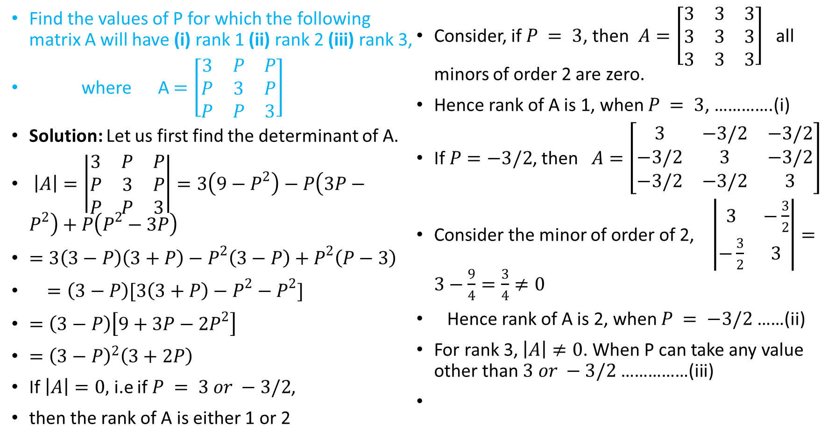
EXAMPLES
Find the values of P for which the following matrix A will have (i) rank 1 (ii) rank 2 (iii) rank 3,
where A$=\left[\begin{matrix}3 & P & P \\ P & 3 & P \\ P & P & 3\end{matrix}\right]$
Solution: Let us first find the determinant of A.
$\left|A\right|=\left|\begin{matrix}3 & P & P \\ P & 3 & P \\ P & P & 3\end{matrix}\right|=3\left(9−P^{2}\right)−P\left(3P−P^{2}\right)+P\left(P^{2}−3P\right)$
$=3\left(3−P\right)\left(3+P\right)−P^{2}\left(3−P\right)+P^{2}\left(P−3\right)$
$=\left(3−P\right)[3\left(3+P\right)−P^{2}−P^{2}]$
$=\left(3−P\right)\left[9+3P−{2P}^{2}\right]$
$={\left(3−P\right)}^{2}\left(3+2P\right)$
If $\left|A\right|=0,$ i.e if $P = 3 or −3/2$,
then the rank of A is either 1 or 2
Consider, if $P = 3$, then $A=\left[\begin{matrix}3 & 3 & 3 \\ 3 & 3 & 3 \\ 3 & 3 & 3\end{matrix}\right]$ all minors of order 2 are zero.
Hence rank of A is 1, when $P = 3$, ………….(i)
If $P=−3/2$, then $A=\left[\begin{matrix}3 & −3/2 & −3/2 \\ −3/2 & 3 & −3/2 \\ −3/2 & −3/2 & 3\end{matrix}\right]$
Consider the minor of order of 2, $\left|\begin{matrix}3 & −\frac{3}{2} \\ −\frac{3}{2} & 3\end{matrix}\right|=3−\frac{9}{4}=\frac{3}{4}≠0$
Hence rank of A is 2, when $P = −3/2$ ……(ii)
For rank 3, $\left|A\right|≠0$. When P can take any value other than $3 or −3/2$ ……………(iii)

Slide 20
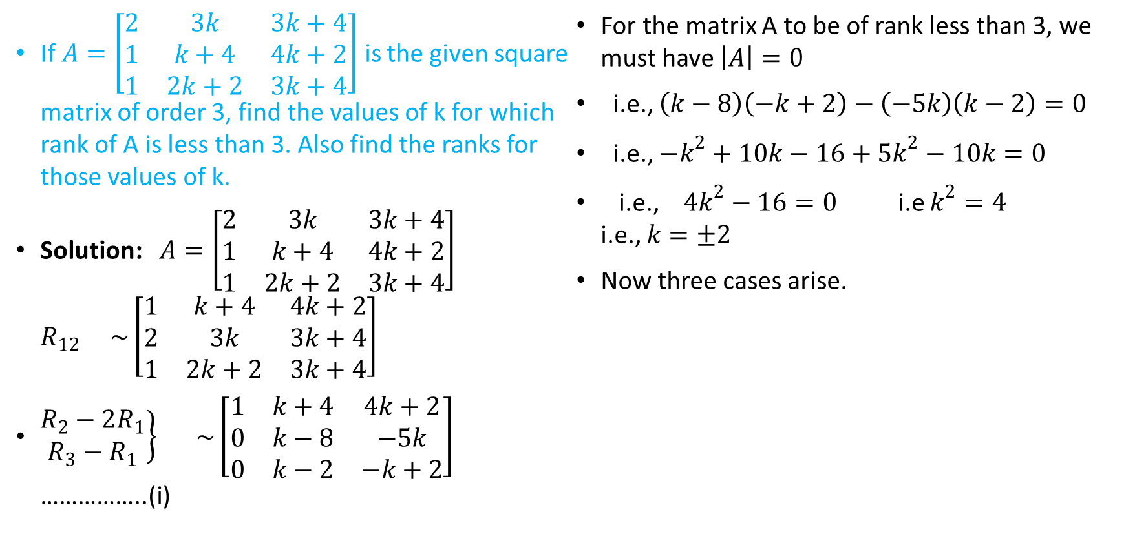
EXAMPLES
If $A=\left[\begin{matrix}2 & 3k & 3k+4 \\ 1 & k+4 & 4k+2 \\ 1 & 2k+2 & 3k+4\end{matrix}\right]$ is the given square matrix of order 3, find the values of k for which rank of A is less than 3. Also find the ranks for those values of k.
Solution: $A=\left[\begin{matrix}2 & 3k & 3k+4 \\ 1 & k+4 & 4k+2 \\ 1 & 2k+2 & 3k+4\end{matrix}\right]$ $R_{12} \sim \left[\begin{matrix}1 & k+4 & 4k+2 \\ 2 & 3k & 3k+4 \\ 1 & 2k+2 & 3k+4\end{matrix}\right]$
$\left.\begin{matrix}R_{2}−2R_{1} \\ R_{3}−R_{1}\end{matrix}\right\} \sim \left[\begin{matrix}1 & k+4 & 4k+2 \\ 0 & k−8 & −5k \\ 0 & k−2 & −k+2\end{matrix}\right]$ ……………..(i)
For the matrix A to be of rank less than 3, we must have $\left|A\right|=0$
i.e., $\left(k−8\right)\left(−k+2\right)−\left(−5k\right)\left(k−2\right)=0$
i.e., $−k^{2}+10k−16+5k^{2}−10k=0$
i.e., ${4k}^{2}−16=0$ i.e $k^{2}=4$ i.e., $k=±2$
Now three cases arise.

Slide 21
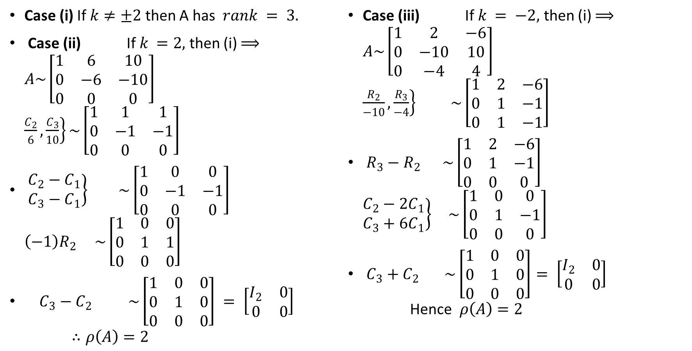
EXAMPLES
Case (i) If $k≠±2$ then A has $rank = 3.$
Case (ii) If $k =2,$ then (i) $⟹$ $A\sim \left[\begin{matrix}1 & 6 & 10 \\ 0 & −6 & −10 \\ 0 & 0 & 0\end{matrix}\right]$ $\left.\frac{C_{2}}{6}, \frac{C_{3}}{10}\right\}\sim \left[\begin{matrix}1 & 1 & 1 \\ 0 & −1 & −1 \\ 0 & 0 & 0\end{matrix}\right]$
$\left.\begin{matrix}C_{2}−C_{1} \\ C_{3}−C_{1}\end{matrix}\right\} \sim \left[\begin{matrix}1 & 0 & 0 \\ 0 & −1 & −1 \\ 0 & 0 & 0\end{matrix}\right]$ $\left(−1\right)R_{2} \sim \left[\begin{matrix}1 & 0 & 0 \\ 0 & 1 & 1 \\ 0 & 0 & 0\end{matrix}\right]$
$C_{3}−C_{2} \sim \left[\begin{matrix}1 & 0 & 0 \\ 0 & 1 & 0 \\ 0 & 0 & 0\end{matrix}\right] = \left[\begin{matrix}I_{2} & 0 \\ 0 & 0\end{matrix}\right]$ $∴ρ\left(A\right)=2$
Case (iii) If $k = −2,$ then (i) $⟹$ $A\sim \left[\begin{matrix}1 & 2 & −6 \\ 0 & −10 & 10 \\ 0 & −4 & 4\end{matrix}\right]$ $\left.\frac{R_{2}}{−10}, \frac{R_{3}}{−4}\right\} \sim \left[\begin{matrix}1 & 2 & −6 \\ 0 & 1 & −1 \\ 0 & 1 & −1\end{matrix}\right]$
$R_{3}−R_{2} \sim \left[\begin{matrix}1 & 2 & −6 \\ 0 & 1 & −1 \\ 0 & 0 & 0\end{matrix}\right]$ $\left.\begin{matrix}C_{2}−2C_{1} \\ C_{3}+6C_{1}\end{matrix}\right\} \sim \left[\begin{matrix}1 & 0 & 0 \\ 0 & 1 & −1 \\ 0 & 0 & 0\end{matrix}\right]$
$C_{3}+C_{2} \sim \left[\begin{matrix}1 & 0 & 0 \\ 0 & 1 & 0 \\ 0 & 0 & 0\end{matrix}\right]= \left[\begin{matrix}I_{2} & 0 \\ 0 & 0\end{matrix}\right]$ Hence $ρ\left(A\right)=2$

Slide 22
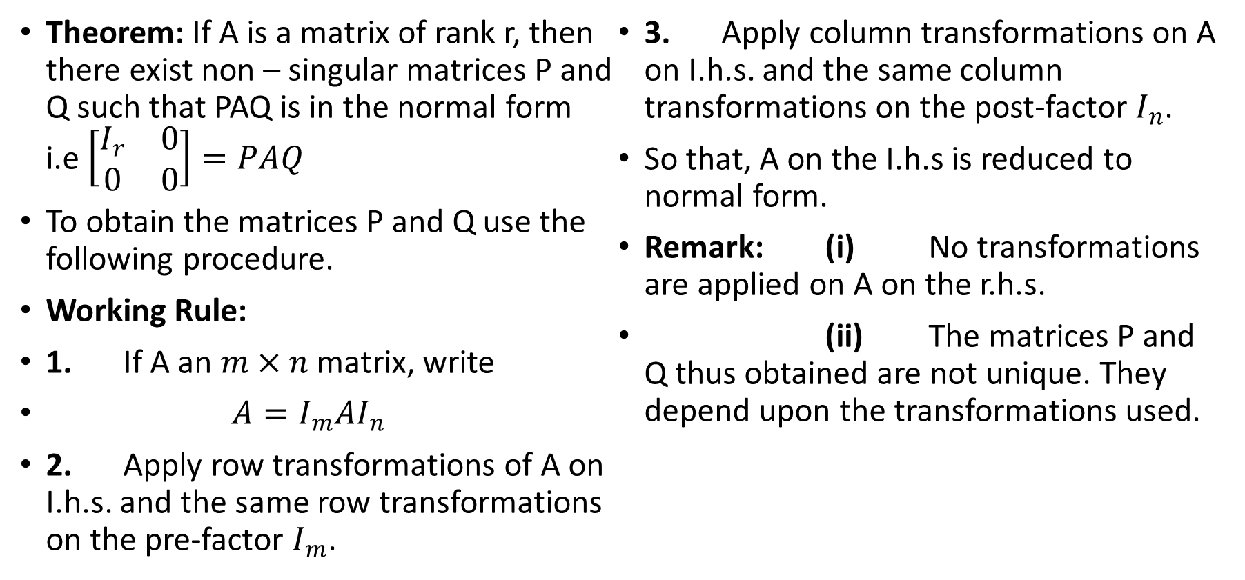
REDUCTION OF A MATRIX A TO NORMAL FORM PAQ
Theorem: If A is a matrix of rank r, then there exist non – singular matrices P and Q such that PAQ is in the normal form i.e $\left[\begin{matrix}I_{r} & 0 \\ 0 & 0\end{matrix}\right]=PAQ$
To obtain the matrices P and Q use the following procedure.
Working Rule:
1. If A an $m×n$ matrix, write
$A=I_{m}AI_{n}$
2. Apply row transformations of A on I.h.s. and the same row transformations on the pre-factor $I_{m}$.
3. Apply column transformations on A on I.h.s. and the same column transformations on the post-factor $I_{n}$.
So that, A on the I.h.s is reduced to normal form.
Remark: (i) No transformations are applied on A on the r.h.s.
(ii) The matrices P and Q thus obtained are not unique. They depend upon the transformations used.

Slide 23
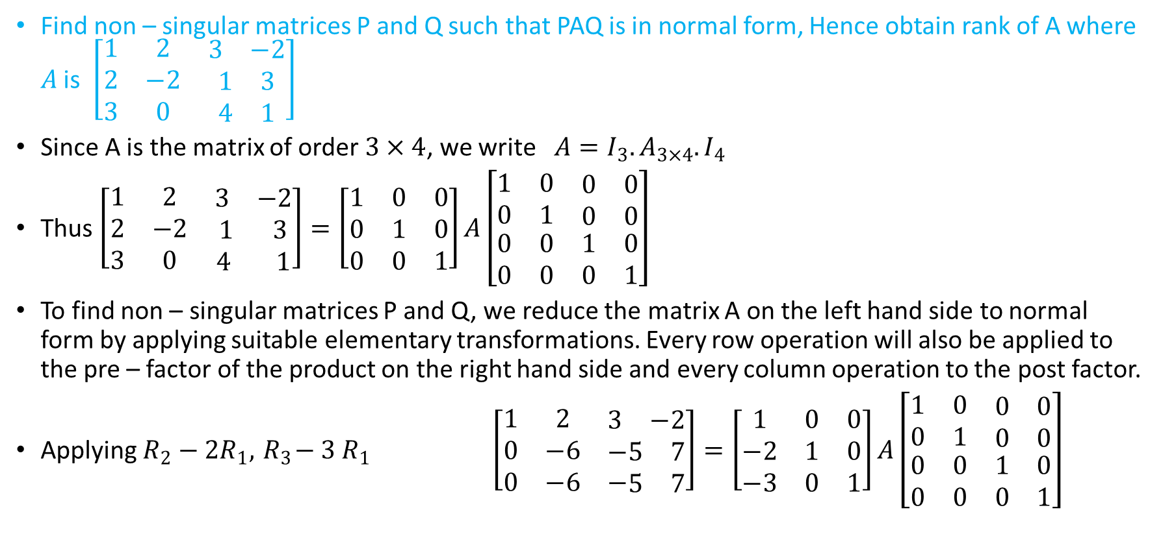
EXAMPLES
Find non – singular matrices P and Q such that PAQ is in normal form, Hence obtain rank of A where $A$ is $\left[\begin{matrix}1 & 2 & \begin{matrix}3 & −2\end{matrix} \\ 2 & −2 & \begin{matrix}1 & 3\end{matrix} \\ 3 & 0 & \begin{matrix}4 & 1\end{matrix}\end{matrix}\right]$
Since A is the matrix of order $3×4$, we write $A=I_{3}.A_{3×4}.I_{4}$
Thus $\left[\begin{matrix}1 & 2 & \begin{matrix}3 & −2\end{matrix} \\ 2 & −2 & \begin{matrix}1 & 3\end{matrix} \\ 3 & 0 & \begin{matrix}4 & 1\end{matrix}\end{matrix}\right]=\left[\begin{matrix}1 & 0 & 0 \\ 0 & 1 & 0 \\ 0 & 0 & 1\end{matrix}\right]A\left[\begin{matrix}1 & 0 & \begin{matrix}0 & 0\end{matrix} \\ 0 & 1 & \begin{matrix}0 & 0\end{matrix} \\ \begin{matrix}0 \\ 0\end{matrix} & \begin{matrix}0 \\ 0\end{matrix} & \begin{matrix}\begin{matrix}1 \\ 0\end{matrix} & \begin{matrix}0 \\ 1\end{matrix}\end{matrix}\end{matrix}\right]$
To find non – singular matrices P and Q, we reduce the matrix A on the left hand side to normal form by applying suitable elementary transformations. Every row operation will also be applied to the pre – factor of the product on the right hand side and every column operation to the post factor.
Applying $R_{2}−2R_{1}, { R}_{3}− 3 R_{1}$ $\left[\begin{matrix}1 & 2 & \begin{matrix}3 & −2\end{matrix} \\ 0 & −6 & \begin{matrix}−5 & 7\end{matrix} \\ 0 & −6 & −\begin{matrix}5 & 7\end{matrix}\end{matrix}\right]=\left[\begin{matrix}1 & 0 & 0 \\ −2 & 1 & 0 \\ −3 & 0 & 1\end{matrix}\right]A\left[\begin{matrix}1 & 0 & \begin{matrix}0 & 0\end{matrix} \\ 0 & 1 & \begin{matrix}0 & 0\end{matrix} \\ \begin{matrix}0 \\ 0\end{matrix} & \begin{matrix}0 \\ 0\end{matrix} & \begin{matrix}\begin{matrix}1 \\ 0\end{matrix} & \begin{matrix}0 \\ 1\end{matrix}\end{matrix}\end{matrix}\right]$

Slide 24
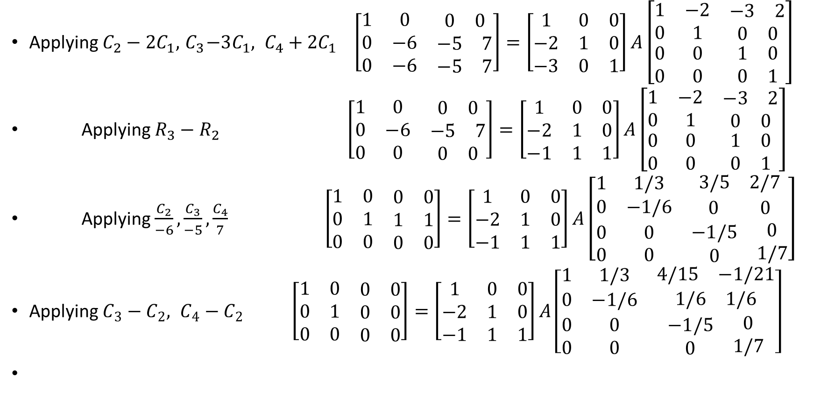
EXAMPLES
Applying $C_{2}−2C_{1}, { C}_{3}−3C_{1}, C_{4}+2C_{1}$ $\left[\begin{matrix}1 & 0 & \begin{matrix}0 & 0\end{matrix} \\ 0 & −6 & \begin{matrix}−5 & 7\end{matrix} \\ 0 & −6 & \begin{matrix}−5 & 7\end{matrix}\end{matrix}\right]=\left[\begin{matrix}1 & 0 & 0 \\ −2 & 1 & 0 \\ −3 & 0 & 1\end{matrix}\right]A\left[\begin{matrix}1 & −2 & \begin{matrix}−3 & 2\end{matrix} \\ 0 & 1 & \begin{matrix}0 & 0\end{matrix} \\ \begin{matrix}0 \\ 0\end{matrix} & \begin{matrix}0 \\ 0\end{matrix} & \begin{matrix}\begin{matrix}1 \\ 0\end{matrix} & \begin{matrix}0 \\ 1\end{matrix}\end{matrix}\end{matrix}\right]$
Applying $R_{3}−R_{2}$ $\left[\begin{matrix}1 & 0 & \begin{matrix}0 & 0\end{matrix} \\ 0 & −6 & \begin{matrix}−5 & 7\end{matrix} \\ 0 & 0 & \begin{matrix}0 & 0\end{matrix}\end{matrix}\right]=\left[\begin{matrix}1 & 0 & 0 \\ −2 & 1 & 0 \\ −1 & 1 & 1\end{matrix}\right]A\left[\begin{matrix}1 & −2 & \begin{matrix}−3 & 2\end{matrix} \\ 0 & 1 & \begin{matrix}0 & 0\end{matrix} \\ \begin{matrix}0 \\ 0\end{matrix} & \begin{matrix}0 \\ 0\end{matrix} & \begin{matrix}\begin{matrix}1 \\ 0\end{matrix} & \begin{matrix}0 \\ 1\end{matrix}\end{matrix}\end{matrix}\right]$
Applying $\frac{C_{2}}{−6}, \frac{C_{3}}{−5}, \frac{C_{4}}{7}$ $\left[\begin{matrix}1 & 0 & \begin{matrix}0 & 0\end{matrix} \\ 0 & 1 & \begin{matrix}1 & 1\end{matrix} \\ 0 & 0 & \begin{matrix}0 & 0\end{matrix}\end{matrix}\right]=\left[\begin{matrix}1 & 0 & 0 \\ −2 & 1 & 0 \\ −1 & 1 & 1\end{matrix}\right]A\left[\begin{matrix}1 & 1/3 & \begin{matrix}3/5 & 2/7\end{matrix} \\ 0 & −1/6 & \begin{matrix}0 & 0\end{matrix} \\ \begin{matrix}0 \\ 0\end{matrix} & \begin{matrix}0 \\ 0\end{matrix} & \begin{matrix}\begin{matrix}−1/5 \\ 0\end{matrix} & \begin{matrix}0 \\ 1/7\end{matrix}\end{matrix}\end{matrix}\right]$
Applying $C_{3}−C_{2}, C_{4}−C_{2}$ $\left[\begin{matrix}1 & 0 & \begin{matrix}0 & 0\end{matrix} \\ 0 & 1 & \begin{matrix}0 & 0\end{matrix} \\ 0 & 0 & \begin{matrix}0 & 0\end{matrix}\end{matrix}\right]=\left[\begin{matrix}1 & 0 & 0 \\ −2 & 1 & 0 \\ −1 & 1 & 1\end{matrix}\right]A\left[\begin{matrix}1 & 1/3 & \begin{matrix}4/15 & −1/21\end{matrix} \\ 0 & −1/6 & \begin{matrix}1/6 & 1/6\end{matrix} \\ \begin{matrix}0 \\ 0\end{matrix} & \begin{matrix}0 \\ 0\end{matrix} & \begin{matrix}\begin{matrix}−1/5 \\ 0\end{matrix} & \begin{matrix}0 \\ 1/7\end{matrix}\end{matrix}\end{matrix}\right]$

Slide 25
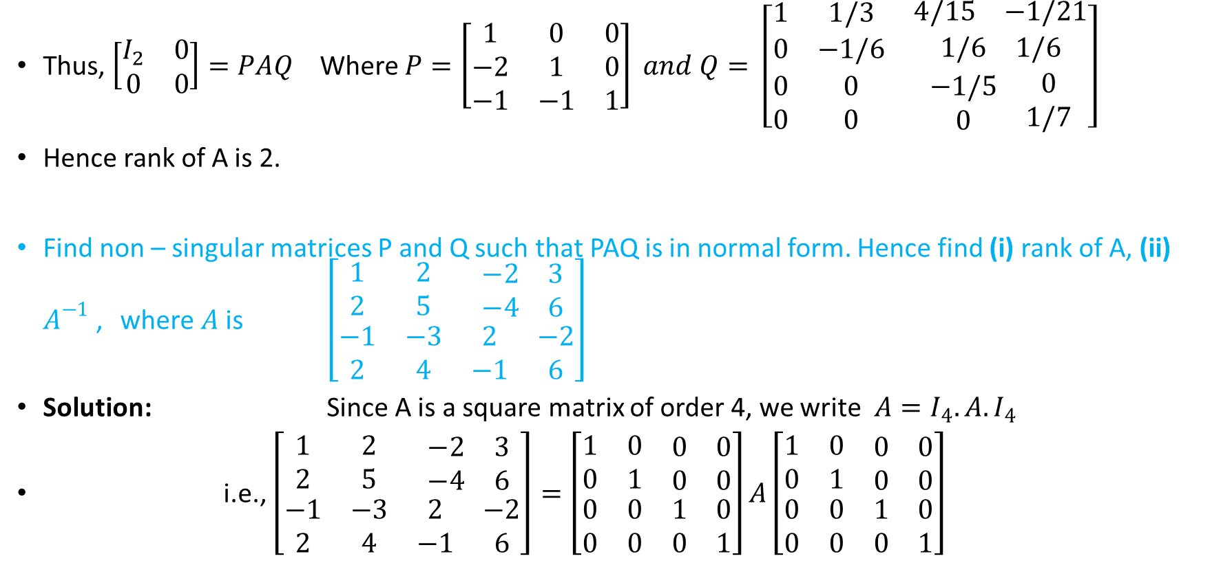
EXAMPLES
Thus, $\left[\begin{matrix}I_{2} & 0 \\ 0 & 0\end{matrix}\right]=PAQ$ Where $P=\left[\begin{matrix}1 & 0 & 0 \\ −2 & 1 & 0 \\ −1 & −1 & 1\end{matrix}\right] and Q= \left[\begin{matrix}1 & 1/3 & \begin{matrix}4/15 & −1/21\end{matrix} \\ 0 & −1/6 & \begin{matrix}1/6 & 1/6\end{matrix} \\ \begin{matrix}0 \\ 0\end{matrix} & \begin{matrix}0 \\ 0\end{matrix} & \begin{matrix}\begin{matrix}−1/5 \\ 0\end{matrix} & \begin{matrix}0 \\ 1/7\end{matrix}\end{matrix}\end{matrix}\right]$
Hence rank of A is 2.
Find non – singular matrices P and Q such that PAQ is in normal form. Hence find (i) rank of A, (ii) $A^{−1}$ , where $A$ is $\left[\begin{matrix}1 & 2 & \begin{matrix}−2 & 3\end{matrix} \\ 2 & 5 & \begin{matrix}−4 & 6\end{matrix} \\ \begin{matrix}−1 \\ 2\end{matrix} & \begin{matrix}−3 \\ 4\end{matrix} & \begin{matrix}\begin{matrix}2 \\ −1\end{matrix} & \begin{matrix}−2 \\ 6\end{matrix}\end{matrix}\end{matrix}\right]$
Solution: Since A is a square matrix of order 4, we write $A=I_{4}.A.I_{4}$
i.e., $\left[\begin{matrix}1 & 2 & \begin{matrix}−2 & 3\end{matrix} \\ 2 & 5 & \begin{matrix}−4 & 6\end{matrix} \\ \begin{matrix}−1 \\ 2\end{matrix} & \begin{matrix}−3 \\ 4\end{matrix} & \begin{matrix}\begin{matrix}2 \\ −1\end{matrix} & \begin{matrix}−2 \\ 6\end{matrix}\end{matrix}\end{matrix}\right]=\left[\begin{matrix}1 & 0 & \begin{matrix}0 & 0\end{matrix} \\ 0 & 1 & \begin{matrix}0 & 0\end{matrix} \\ \begin{matrix}0 \\ 0\end{matrix} & \begin{matrix}0 \\ 0\end{matrix} & \begin{matrix}\begin{matrix}1 \\ 0\end{matrix} & \begin{matrix}0 \\ 1\end{matrix}\end{matrix}\end{matrix}\right]A\left[\begin{matrix}1 & 0 & \begin{matrix}0 & 0\end{matrix} \\ 0 & 1 & \begin{matrix}0 & 0\end{matrix} \\ \begin{matrix}0 \\ 0\end{matrix} & \begin{matrix}0 \\ 0\end{matrix} & \begin{matrix}\begin{matrix}1 \\ 0\end{matrix} & \begin{matrix}0 \\ 1\end{matrix}\end{matrix}\end{matrix}\right]$

Slide 26
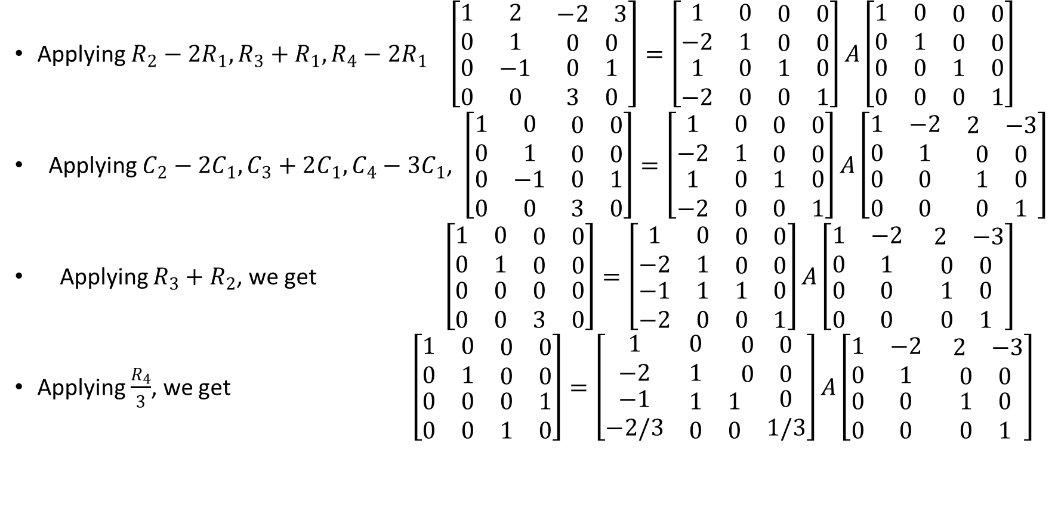
EXAMPLES
Applying $R_{2}−2R_{1}, R_{3}+R_{1}, R_{4}−2R_{1}$ $\left[\begin{matrix}1 & 2 & \begin{matrix}−2 & 3\end{matrix} \\ 0 & 1 & \begin{matrix}0 & 0\end{matrix} \\ \begin{matrix}0 \\ 0\end{matrix} & \begin{matrix}−1 \\ 0\end{matrix} & \begin{matrix}\begin{matrix}0 \\ 3\end{matrix} & \begin{matrix}1 \\ 0\end{matrix}\end{matrix}\end{matrix}\right]=\left[\begin{matrix}1 & 0 & \begin{matrix}0 & 0\end{matrix} \\ −2 & 1 & \begin{matrix}0 & 0\end{matrix} \\ \begin{matrix}1 \\ −2\end{matrix} & \begin{matrix}0 \\ 0\end{matrix} & \begin{matrix}\begin{matrix}1 \\ 0\end{matrix} & \begin{matrix}0 \\ 1\end{matrix}\end{matrix}\end{matrix}\right]A\left[\begin{matrix}1 & 0 & \begin{matrix}0 & 0\end{matrix} \\ 0 & 1 & \begin{matrix}0 & 0\end{matrix} \\ \begin{matrix}0 \\ 0\end{matrix} & \begin{matrix}0 \\ 0\end{matrix} & \begin{matrix}\begin{matrix}1 \\ 0\end{matrix} & \begin{matrix}0 \\ 1\end{matrix}\end{matrix}\end{matrix}\right]$
Applying $C_{2}−2C_{1}, C_{3}+2C_{1}, C_{4}−3C_{1}$, $\left[\begin{matrix}1 & 0 & \begin{matrix}0 & 0\end{matrix} \\ 0 & 1 & \begin{matrix}0 & 0\end{matrix} \\ \begin{matrix}0 \\ 0\end{matrix} & \begin{matrix}−1 \\ 0\end{matrix} & \begin{matrix}\begin{matrix}0 \\ 3\end{matrix} & \begin{matrix}1 \\ 0\end{matrix}\end{matrix}\end{matrix}\right]=\left[\begin{matrix}1 & 0 & \begin{matrix}0 & 0\end{matrix} \\ −2 & 1 & \begin{matrix}0 & 0\end{matrix} \\ \begin{matrix}1 \\ −2\end{matrix} & \begin{matrix}0 \\ 0\end{matrix} & \begin{matrix}\begin{matrix}1 \\ 0\end{matrix} & \begin{matrix}0 \\ 1\end{matrix}\end{matrix}\end{matrix}\right]A\left[\begin{matrix}1 & −2 & \begin{matrix}2 & −3\end{matrix} \\ 0 & 1 & \begin{matrix}0 & 0\end{matrix} \\ \begin{matrix}0 \\ 0\end{matrix} & \begin{matrix}0 \\ 0\end{matrix} & \begin{matrix}\begin{matrix}1 \\ 0\end{matrix} & \begin{matrix}0 \\ 1\end{matrix}\end{matrix}\end{matrix}\right]$
Applying $R_{3}+R_{2}$, we get $\left[\begin{matrix}1 & 0 & \begin{matrix}0 & 0\end{matrix} \\ 0 & 1 & \begin{matrix}0 & 0\end{matrix} \\ \begin{matrix}0 \\ 0\end{matrix} & \begin{matrix}0 \\ 0\end{matrix} & \begin{matrix}\begin{matrix}0 \\ 3\end{matrix} & \begin{matrix}0 \\ 0\end{matrix}\end{matrix}\end{matrix}\right]=\left[\begin{matrix}1 & 0 & \begin{matrix}0 & 0\end{matrix} \\ −2 & 1 & \begin{matrix}0 & 0\end{matrix} \\ \begin{matrix}−1 \\ −2\end{matrix} & \begin{matrix}1 \\ 0\end{matrix} & \begin{matrix}\begin{matrix}1 \\ 0\end{matrix} & \begin{matrix}0 \\ 1\end{matrix}\end{matrix}\end{matrix}\right]A\left[\begin{matrix}1 & −2 & \begin{matrix} 2 & −3\end{matrix} \\ 0 & 1 & \begin{matrix}0 & 0\end{matrix} \\ \begin{matrix}0 \\ 0\end{matrix} & \begin{matrix}0 \\ 0\end{matrix} & \begin{matrix}\begin{matrix}1 \\ 0\end{matrix} & \begin{matrix}0 \\ 1\end{matrix}\end{matrix}\end{matrix}\right]$
Applying $\frac{R_{4}}{3}$, we get $\left[\begin{matrix}1 & 0 & \begin{matrix}0 & 0\end{matrix} \\ 0 & 1 & \begin{matrix}0 & 0\end{matrix} \\ \begin{matrix}0 \\ 0\end{matrix} & \begin{matrix}0 \\ 0\end{matrix} & \begin{matrix}\begin{matrix}0 \\ 1\end{matrix} & \begin{matrix}1 \\ 0\end{matrix}\end{matrix}\end{matrix}\right]=\left[\begin{matrix}1 & 0 & \begin{matrix}0 & 0\end{matrix} \\ −2 & 1 & \begin{matrix}0 & 0\end{matrix} \\ \begin{matrix}−1 \\ −2/3\end{matrix} & \begin{matrix}1 \\ 0\end{matrix} & \begin{matrix}\begin{matrix}1 \\ 0\end{matrix} & \begin{matrix}0 \\ 1/3\end{matrix}\end{matrix}\end{matrix}\right]A\left[\begin{matrix}1 & −2 & \begin{matrix} 2 & −3\end{matrix} \\ 0 & 1 & \begin{matrix}0 & 0\end{matrix} \\ \begin{matrix}0 \\ 0\end{matrix} & \begin{matrix}0 \\ 0\end{matrix} & \begin{matrix}\begin{matrix}1 \\ 0\end{matrix} & \begin{matrix}0 \\ 1\end{matrix}\end{matrix}\end{matrix}\right]$

Slide 27
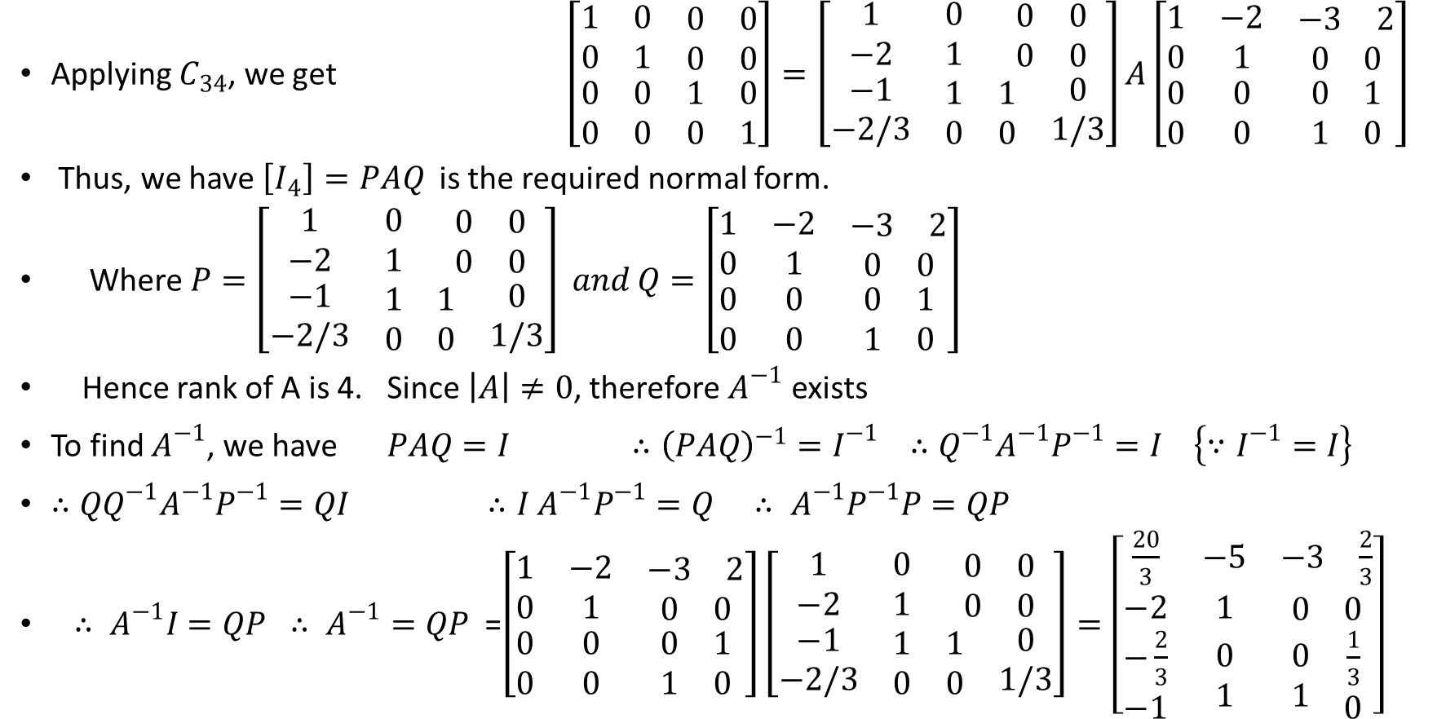
EXAMPLES
Applying $C_{34}$, we get $\left[\begin{matrix}1 & 0 & \begin{matrix}0 & 0\end{matrix} \\ 0 & 1 & \begin{matrix}0 & 0\end{matrix} \\ \begin{matrix}0 \\ 0\end{matrix} & \begin{matrix}0 \\ 0\end{matrix} & \begin{matrix}\begin{matrix}1 \\ 0\end{matrix} & \begin{matrix}0 \\ 1\end{matrix}\end{matrix}\end{matrix}\right]=\left[\begin{matrix}1 & 0 & \begin{matrix}0 & 0\end{matrix} \\ −2 & 1 & \begin{matrix}0 & 0\end{matrix} \\ \begin{matrix}−1 \\ −2/3\end{matrix} & \begin{matrix}1 \\ 0\end{matrix} & \begin{matrix}\begin{matrix}1 \\ 0\end{matrix} & \begin{matrix}0 \\ 1/3\end{matrix}\end{matrix}\end{matrix}\right]A\left[\begin{matrix}1 & −2 & \begin{matrix}−3 & 2\end{matrix} \\ 0 & 1 & \begin{matrix}0 & 0\end{matrix} \\ \begin{matrix}0 \\ 0\end{matrix} & \begin{matrix}0 \\ 0\end{matrix} & \begin{matrix}\begin{matrix}0 \\ 1\end{matrix} & \begin{matrix}1 \\ 0\end{matrix}\end{matrix}\end{matrix}\right]$
Thus, we have $\left[I_{4}\right]=PAQ$ is the required normal form.
Where $P=\left[\begin{matrix}1 & 0 & \begin{matrix}0 & 0\end{matrix} \\ −2 & 1 & \begin{matrix}0 & 0\end{matrix} \\ \begin{matrix}−1 \\ −2/3\end{matrix} & \begin{matrix}1 \\ 0\end{matrix} & \begin{matrix}\begin{matrix}1 \\ 0\end{matrix} & \begin{matrix}0 \\ 1/3\end{matrix}\end{matrix}\end{matrix}\right] and Q=\left[\begin{matrix}1 & −2 & \begin{matrix}−3 & 2\end{matrix} \\ 0 & 1 & \begin{matrix}0 & 0\end{matrix} \\ \begin{matrix}0 \\ 0\end{matrix} & \begin{matrix}0 \\ 0\end{matrix} & \begin{matrix}\begin{matrix}0 \\ 1\end{matrix} & \begin{matrix}1 \\ 0\end{matrix}\end{matrix}\end{matrix}\right]$
Hence rank of A is 4. Since $\left|A\right|≠0$, therefore $A^{−1}$ exists
To find $A^{−1}$, we have $PAQ=I$ $∴{\left(PAQ\right)}^{−1}=I^{−1}$ $∴Q^{−1}A^{−1}P^{−1}=I$ $\left\{∵I^{−1}=I\right\}$
$∴{QQ}^{−1}A^{−1}P^{−1}=QI$ $∴I A^{−1}P^{−1}=Q$ $∴ A^{−1}P^{−1}P=QP$
$∴ A^{−1}I=QP$ $∴ A^{−1}=QP$ =$\left[\begin{matrix}1 & −2 & \begin{matrix}−3 & 2\end{matrix} \\ 0 & 1 & \begin{matrix}0 & 0\end{matrix} \\ \begin{matrix}0 \\ 0\end{matrix} & \begin{matrix}0 \\ 0\end{matrix} & \begin{matrix}\begin{matrix}0 \\ 1\end{matrix} & \begin{matrix}1 \\ 0\end{matrix}\end{matrix}\end{matrix}\right]\left[\begin{matrix}1 & 0 & \begin{matrix}0 & 0\end{matrix} \\ −2 & 1 & \begin{matrix}0 & 0\end{matrix} \\ \begin{matrix}−1 \\ −2/3\end{matrix} & \begin{matrix}1 \\ 0\end{matrix} & \begin{matrix}\begin{matrix}1 \\ 0\end{matrix} & \begin{matrix}0 \\ 1/3\end{matrix}\end{matrix}\end{matrix}\right]=\left[\begin{matrix}\frac{20}{3} & −5 & \begin{matrix}−3 & \frac{2}{3}\end{matrix} \\ −2 & 1 & \begin{matrix}0 & 0\end{matrix} \\ \begin{matrix}−\frac{2}{3} \\ −1\end{matrix} & \begin{matrix}0 \\ 1\end{matrix} & \begin{matrix}\begin{matrix}0 \\ 1\end{matrix} & \begin{matrix}\frac{1}{3} \\ 0\end{matrix}\end{matrix}\end{matrix}\right]$

